Slide 1
Copernicus Climate Change Service
Jean-Noël Thépaut
Status Update

Slide 2

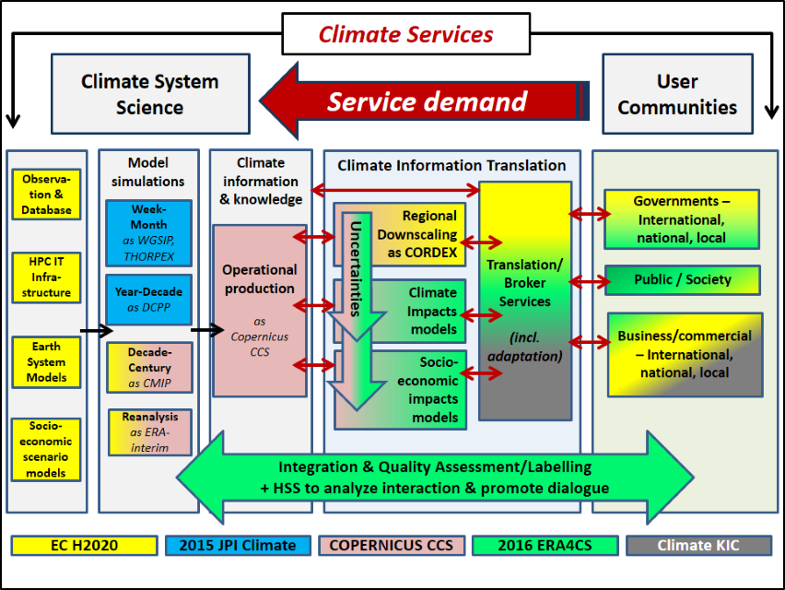
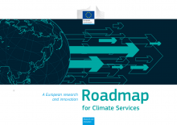
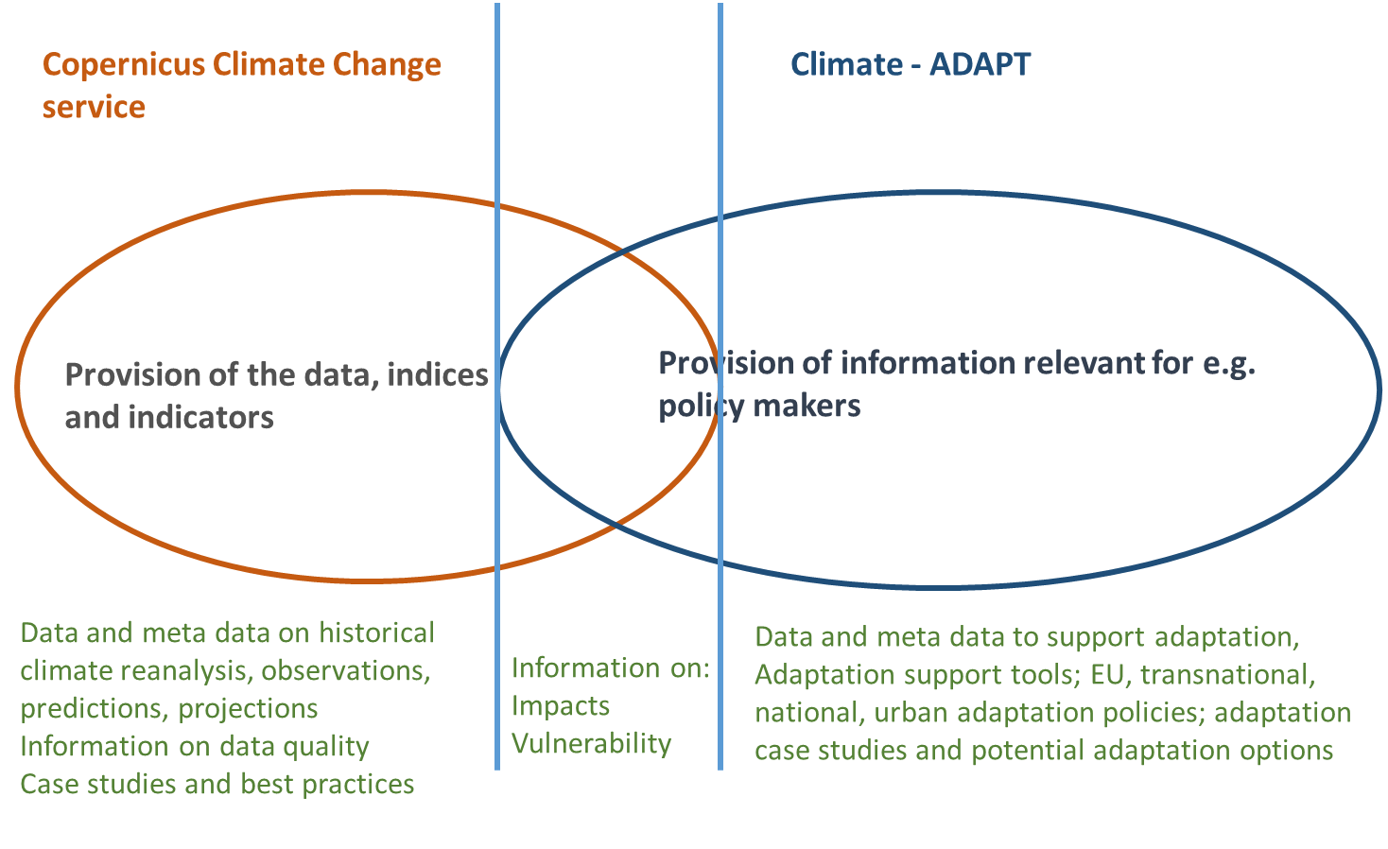
Copernicus Climate Change Service
Role of C3S in European Climate Services landscape
Background document
… work in progress …
Credit: P. Monfray, JPI Climate
André Jol, EEA

Slide 3
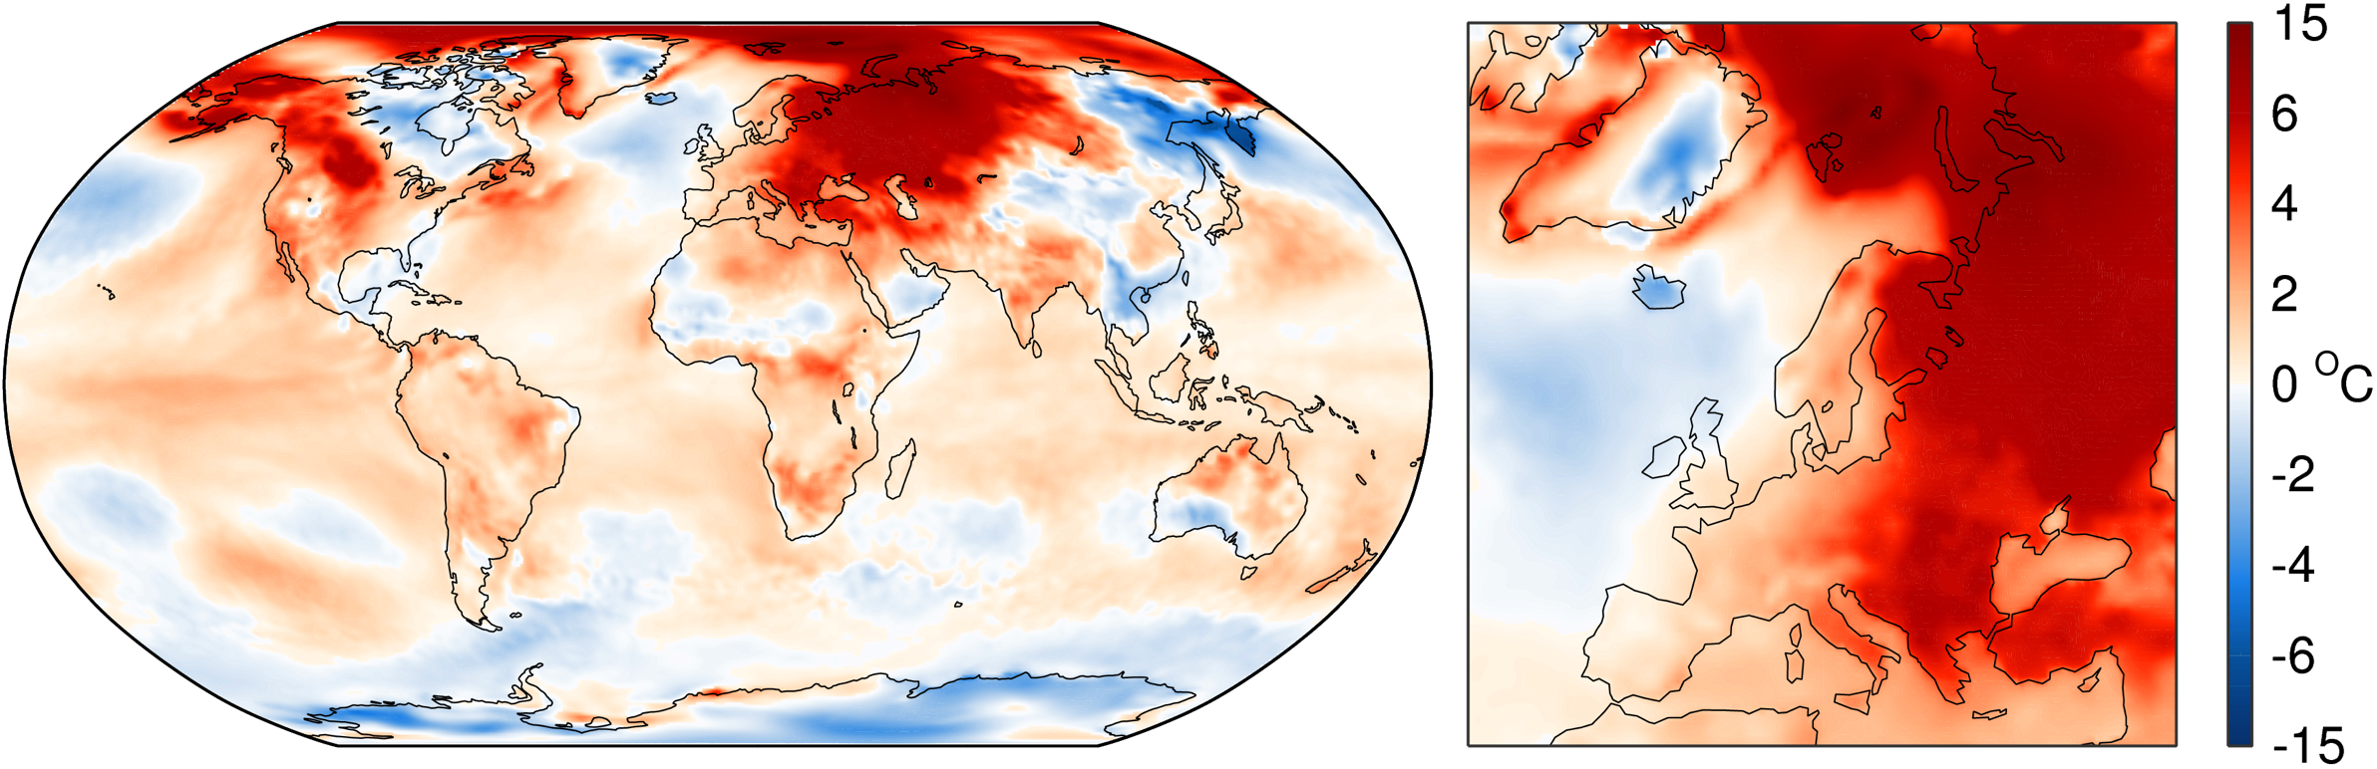
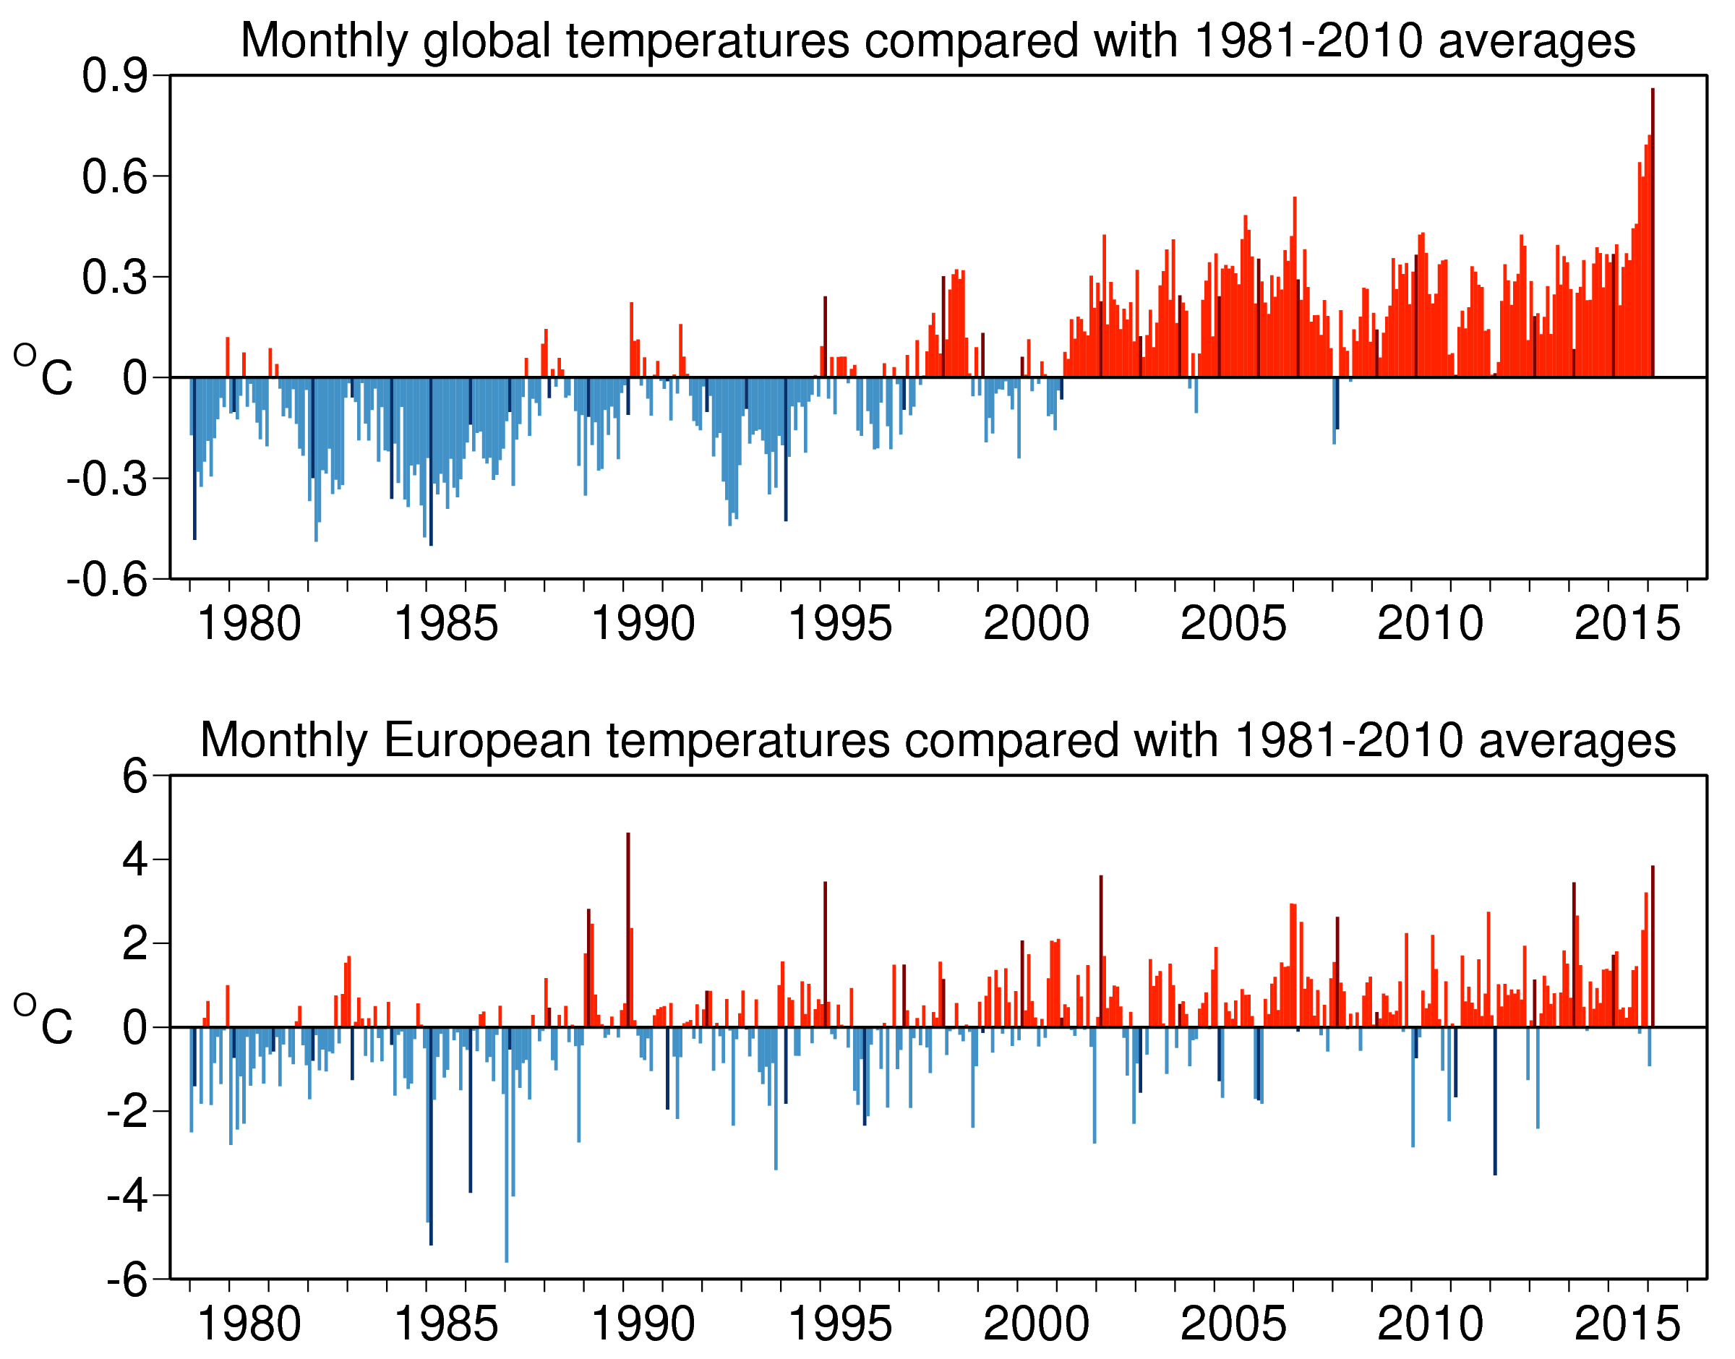
Climate monitoring
Copernicus Climate Change Service
Demonstrator of a European Climate Service of Reference
Combining
models and
observations
+ ~0.8ºC
The 16 warmest years on record: 1998 and 2001-2015
the latest 12-month mean exceeds 0.5K
Issued on 9 March 2016

Slide 4
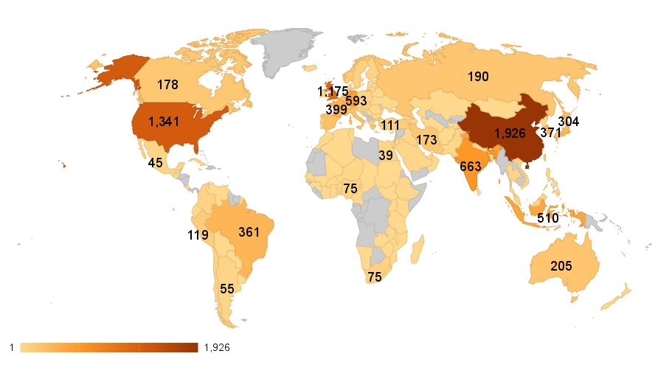
ERA-Interim users (2015)
Copernicus Climate Change Service
Demonstrator of a European Climate Service of Reference

Slide 5

C3S components
Climate
Data Store
Sectoral
Information
System
Evaluation and
Quality Control
Outreach and Dissemination
  ECVs past, present and future
  Observed, reanalysed and simulated
  Derived climate indicators
  Tools to support adaptation and mitigation at global and European level
Monitors quality of C3S products and services
Ensures C3S delivers state-of-the-art climate information to end-users
Identifies gaps in service provision
Bridges Copernicus with the research agenda in Europe (e.g. H2020, national research projects)
Web content
Public outreach
Coordination with national outreach
Liaison with public authorities
Conferences, seminars
Training and education

Slide 6
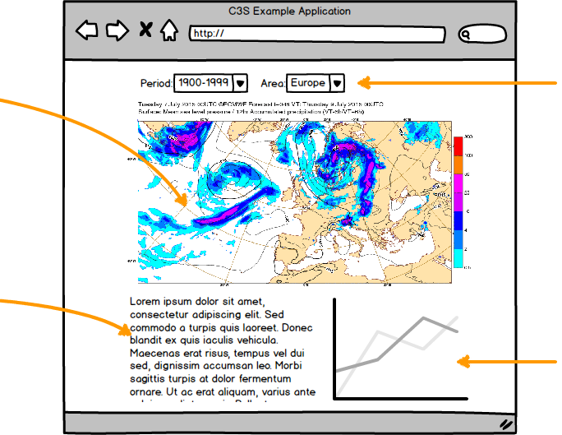
Climate Data Store
Technical challenges:
Diversity of users
Diversity of data sets
Very large data volumes
Data residing at different locations
Interoperability, efficiency
User-defined workflows
Variety of presentation methods
Need for interactivity
Access via API
User management
Performance monitoring
maps
controls
text
graphs

Slide 7
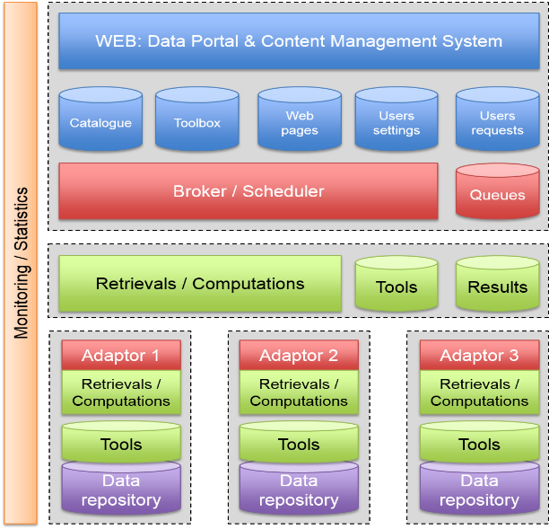
Climate Data Store
Development of CDS software infrastructure
2016 Q1: Start of contract
2016 Q3: Initial release of working prototype for limited testing
2017 Q1: First functional release exposed to a large user group, then quarterly releases with added functionality
2018 Q1: Final release
Development of CDS toolbox
2016 Q2/Q3: Start of contract

Slide 8
CDS data content
Scientific basis:
Essential Climate Variables as defined by GCOS
GCOS Status Report (GCOS-195)
IPCC, CMIP
Observations
Global estimates of ECVs from satellite and in-situ data
Reprocessed CDRs, reference observations
Climate reanalysis
Global atmosphere, ocean, land
Regional reanalysis
Seasonal forecasts and climate projections
Multi-model seasonal forecast products
Access to CMIP data and products
Support for data rescue, climate data collections
Coupled climate reanalysis for 100 years
European multi-model climate projections
Climate Indicators

Slide 9
ECV roadmap

Slide 10
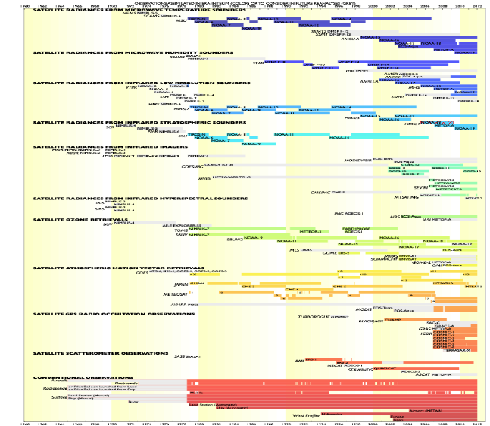
Climate Data Store
Global reanalysis:
ERA5 is now in production
32km global resolution
Uncertainty estimates
Improved use of observations
Newly reprocessed satellite data
Hourly data from 1979-NRT
Access to all input observations
Regional reanalysis:
European domain
Higher spatial resolution
Workshop planned for 2016 Q2
(19-20 May 2016)
Competitive call by 2016 Q4

Slide 11
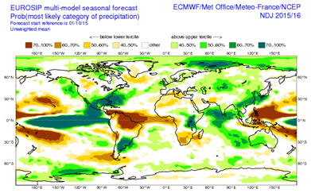
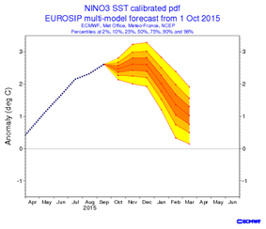
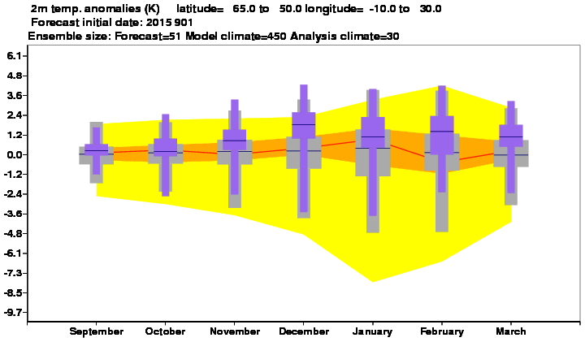
Copernicus Climate Change Service
C3S seasonal forecasts
Aim: to generate multi-model seasonal forecast products based on the best information available, to an operational schedule, and make them publicly available.
Components of the seasonal service:
Forecast data: a list of atmosphere (and ocean) variables, on 1x1 degree grid, at daily or sub-daily resolution, from 6-month forecasts
Graphical products (e.g. time series for indices, maps, climagrams)
Processed data (e.g. indices, probabilities, inputs for SIS)
First set of products will be available starting Q3 2016
Northern Europe; from September 2015

Slide 12










Sectoral Information System
Copernicus Climate Change Service
Proof of concept development of sectoral applications
Copernicus Climate Change Service

Slide 13
Sectoral Information System
Copernicus Climate Change Service
Seven proof of concept SIS contracts have been awarded:
  SIS water management:
    SWICCA (Service for Water Indicators in Climate Change adaptation) – lead SMHI (Sweden)
    EDgE (End-to-End demonstrator for improved decision making in the water sector in Europe) – Lead CEH (UK)
  SIS energy:
    CLIM4ENERGY (Climate for Energy) – Lead CEA (France)
    ECEM (European Climatic Energy Mixes) – Lead UEA (UK)
  SIS others:
    AgriCLASS (Agriculture Climate Advisory Services) – Lead Telespazio – Vega (UK)
    WISC (Windstorm Information Service) – Lead CGI (UK)
    URBAN-SIS (touching health, infrastructure, water) – Lead SMHI (Sweden)

Slide 14
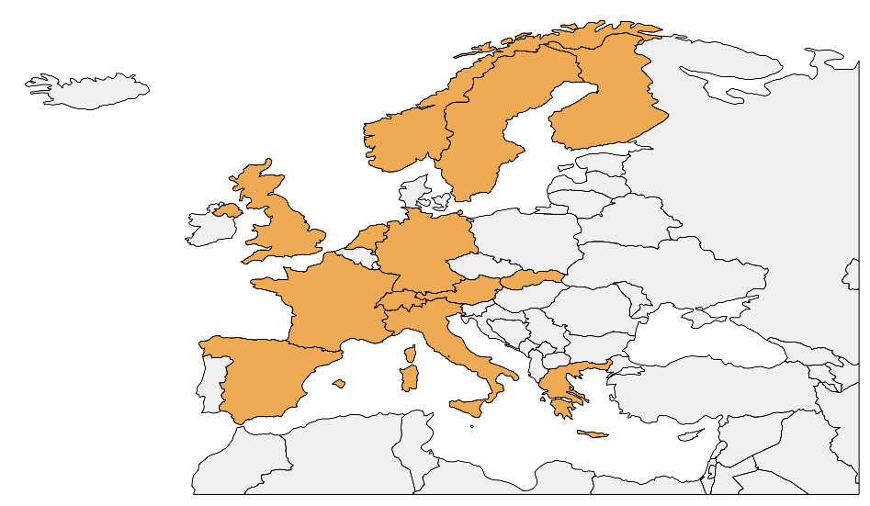
Distribution of SIS PoC suppliers
Copernicus Climate Change Service

Slide 15
Sectoral Information System
Commonalities between the projects
Use input data from the Climate Data Store
- observations, ECVs, reanalyses, seasonal forecasts, climate projections
- additional datasets (from other services, socio-economic data, etc.)
Stakeholders engagement:
- user workshops organised at very early stage (<T+6)
Demonstrators:
- Most use cases demonstrated between (T+12 and T+18)
Wide users trials and feedback

Slide 16
Evaluation and Quality Control
Ensures C3S delivers state-of-the-art climate information to end-users
Identifies gaps in the Service
Bridges Copernicus with Research Agenda in Europe (e.g. H2020, national research projects)
Monitors continually, quality of C3S products and services
“Quality Assurance” body
Will be the instrument to develop the URDB/SES/etc. documents
Strong link with F4P function

Slide 17
Evaluation and Quality Control
  EQC function for the Climate Data Store
    ECV products from model-based reanalyses
    ECV products from observations
    Multi-model seasonal forecast products
    Multi-model climate projections
  EQC for the Sectoral Information System
    EQC framework development
    User requirements, gap analysis and market survey
    Applications development to support EQC of the SIS
    Status: Evaluations being finalised – first negotiations started

Slide 18
Outreach
Copernicus Communication
Common to C3S and CAMS
Copernicus Communication Strategy
Training
Press
PR/outreach
Events
Research & Evaluation

Slide 19
Outreach
Target audience
Primary
Scientists, Academics & Researchers
Policy Makers & local planning authorities
Industry
(Water, Energy, …)
Downstream Specialist SMEs, consultants & businesses
Media
(as multipliers)
Secondary
Educational Institutions
(school students & educators)
Public Segment
(‘Motivated greens’)

Slide 20
Outreach
Communication Strategy:
Three pillars
CLARITY
Planning, measurement & evaluation.
CONTENT
Flexible, understandable, user-centric.
COLLABORATION
People
&
partnerships.
20

Slide 21

INTER SERVICE COORDINATION
C3S is cutting across most other Services
  Datasets from other Services are relevant to C3S and need cross-referencing
  Datasets generated by C3S are relevant to other Services and need cross-referencing
  Tools and good practices have also commonalities
Bilateral discussions are active between C3S and:
CMEMS (ECVs, reanalyses, …),
CAMS (ECVs, reanalyses, …)
Will widen this discussion to other Services (Land, Emergency)
21

Slide 22
Timeline
Stage 0/1 - Proof of Concept/Pre-operational
Stage II - Operational ~20 ECVs, ~5-6 Sectors
Stage III - Operational ~30 ECVs, ~8-10 Sectors
PoC + Pre-operational Phase
2013
2014
2015
2016
2017
2018
2019
2020
2021
Stage 0
Stage I
Stage II
Stage III
Operational Phase

Slide 23
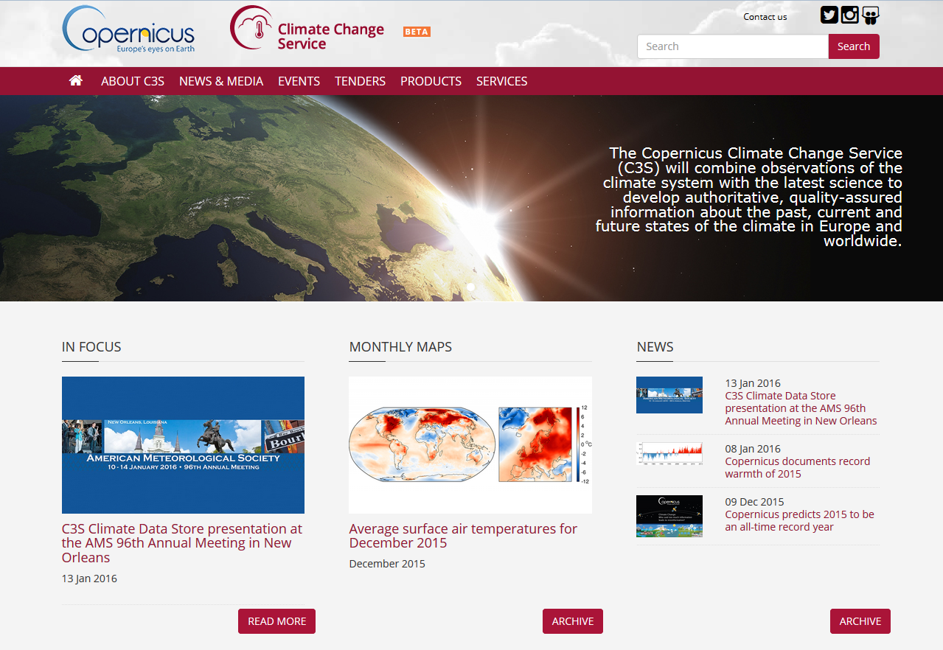
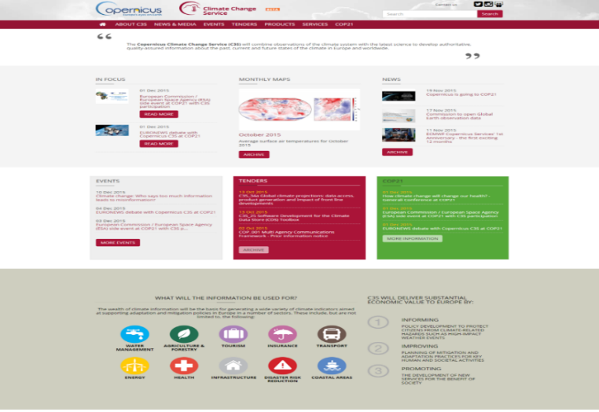
Copernicus Climate Change Service
climate.copernicus.eu
Thank You
23

