Slide 1
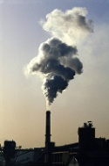
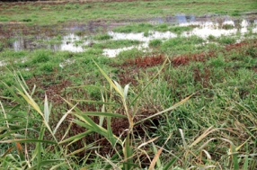
6th CCI-CMUG Meeting
GHG-CCI: Recent scientific results, latest data products, future
Michael Buchwitz
Institute of Environmental Physics (IUP),
University of Bremen, Bremen, Germany
& the GHG-CCI team
The
Inversion
Lab

Slide 2
Outline
Reminder: ECV GHG & GHG-CCI approach
Overview recent (2015+) publications
Overview latest data set (CRDP3)
Cross-ECV activities
Obs4MIPs
Activities until end of ongoing project

Slide 3
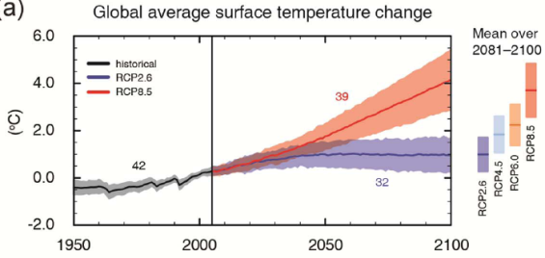
ECV GHG ?
Essential Climate Variable Greenhouse Gases ?
CO₂ and CH₄ are the two most important greenhouse gases emitted by humans & increasing atmospheric concentrations result in global warming.
Reliable climate prediction requires a good understanding of the natural and anthropogenic (surface) sources and sinks of CO₂ and CH₄.
Important questions are, for example
Where are they ?
How strong are they ?
How do they respond to a changing climate ?
A better understanding requires appropriate global observations and (inverse) modelling.
Observed and predicted temperature change (AR5)
Future?
Ecomomie?
Population?
Technology?
GHG sources and sinks?
ECV GHG (GCOS-154^{*)}):
“Retrievals of greenhouse gases, such as CO₂ and CH₄, of sufficient quality to estimate regional sources and sinks.”
*) „SYSTEMATIC OBSERVATION REQUIREMENTS FOR SATELLITE-BASED DATA PRODUCTS FOR CLIMATE“

Slide 4
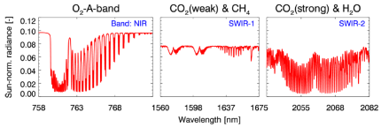
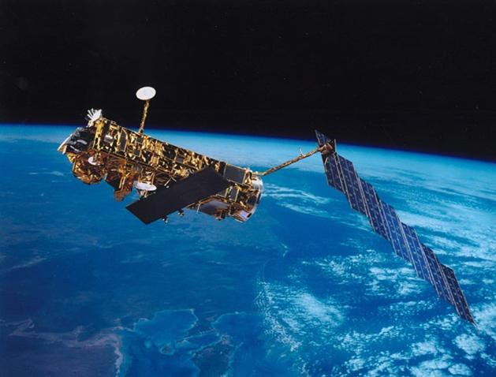
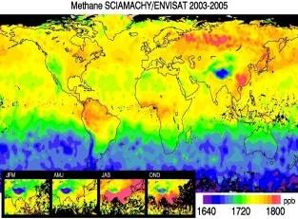
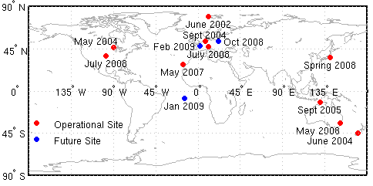
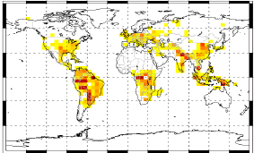
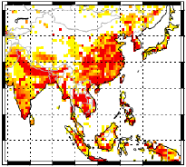
GHG-CCI project www.esa-ghg-cci.org
Global satellite observations
Calibration (L 0-1)
Upper layer
CO₂ & CH₄
Calibrated radiances
Global information on near-surface CO₂ & CH₄
SCIAMACHY/ENVISAT
TANSO/GOSAT
IASI,
MIPAS,
SCIA/occ,
AIRS,
ACE-FTS,
…
Retrieval
(L 1-2)
(Other: OCO-2, S5P, …)
Atmospheric GHG
distributions
Global observations
Reference observations
?
CO₂
Validation
CH₄
CO₂
?
Improved information on
GHG sources & sinks
Inverse modelling
(L 2-4)
CH₄

Slide 5
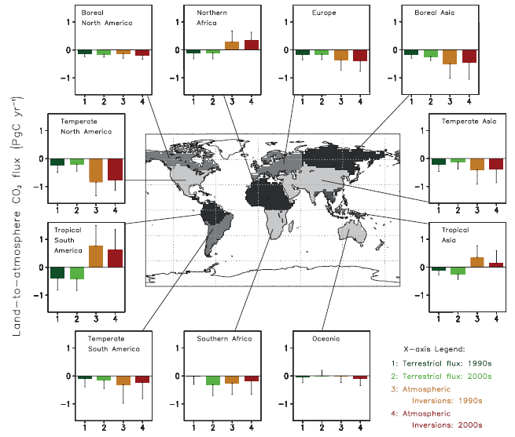
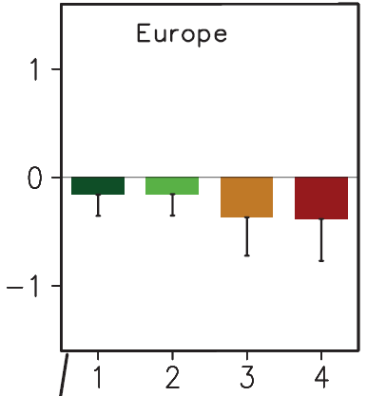
Regional terrestrial biosphere CO₂ fluxes
IPCC 2013, WG1
1990s
2000s
Dynamic
vegetation
models
Decadal fluxes
via atmospheric inversions
mostly CO₂ flask measurements (very accurate but sparse) (Peylin et al., 2013)
without satellite CO₂
Large discrepancies models vs atmospheric inversions
esp. in tropics and northern Africa & large uncertainties (~100%) !
Can we do better using satellite XCO₂ ?

Slide 6
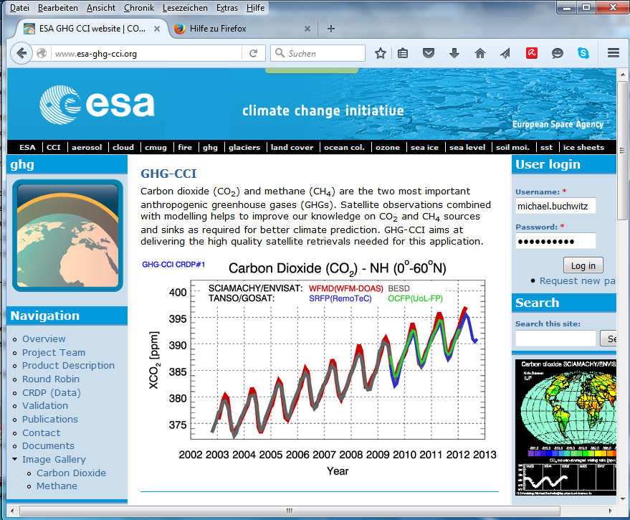
GHG-CCI: Publications
Number of peer-reviewed publications using GHG-CCI data sets / GHG-CCI funding acknowledged:
49
(Status: 15-Mar-2016)

Slide 7
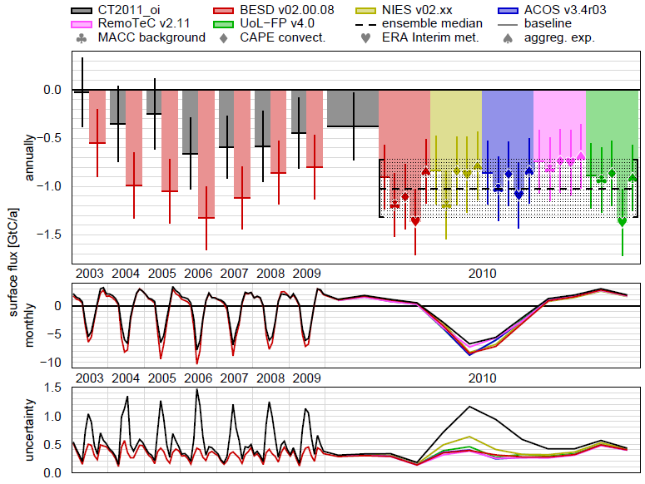
European carbon sink
„Europe only“ inversion using STILT-based short range (days)
particle dispersion modelling using an ensemble of satellite XCO₂ retrievals:
Reuter et al.,
ACP, 2014
2 satellites
5 retrieval algorithms / products
New flux inversion method insensitive to observations outside Europe, large-range transport & other errors
Various sensitivity studies
Satellite data suggest a (TransCom region) European C sink of 1.02 +/- 0.3 GtC/yr (for 2010)
CT
Satellite

Slide 8
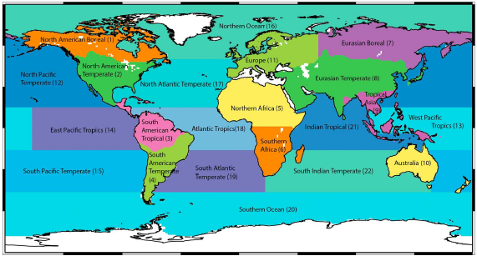
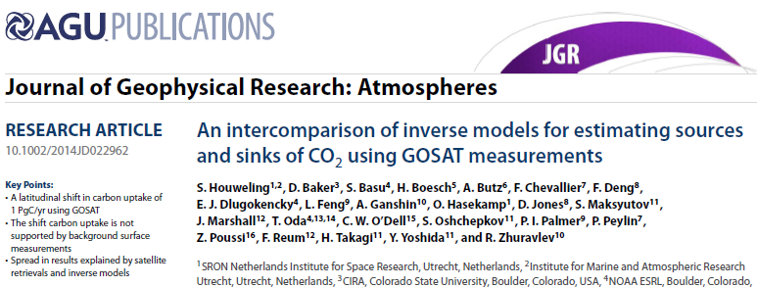
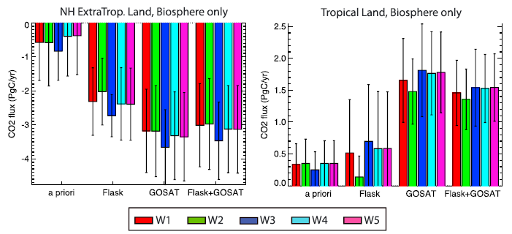
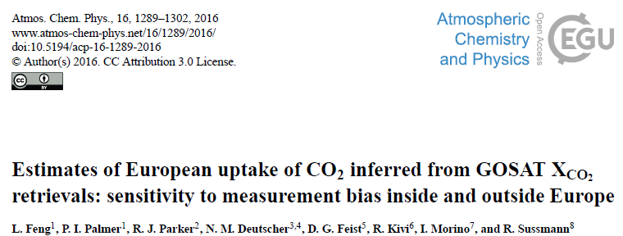
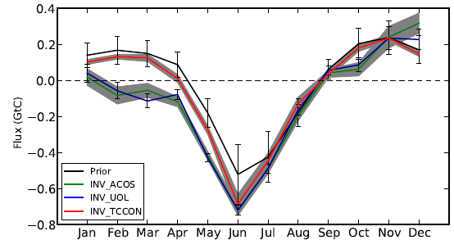
GHG-CCI: Recent Publications:
CO₂ sources/sinks (eg Europe)
Houweling et al., 2015
Ensemble of inversion models & methods and GOSAT products
Adding GOSAT: Europe a stronger CO₂ sink and Northern Africa a stronger source
Real or modelling / satellite bias artefact?
Feng et al., 2015
„… we cannot prove or disprove that European ecosystems are taking up a larger-than-expected amount of CO₂.“

Slide 9
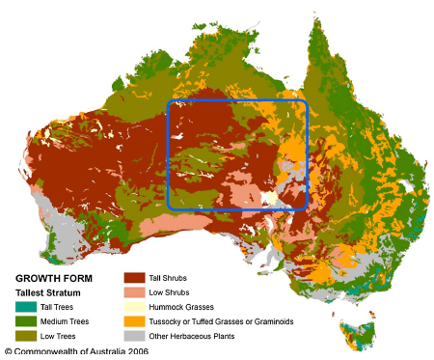
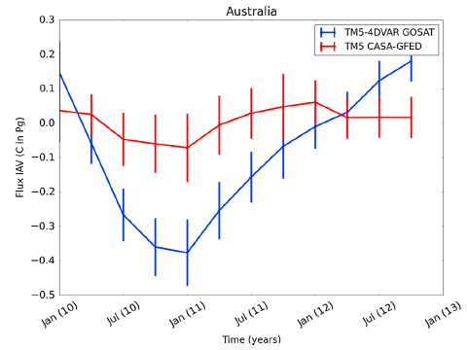
GHG-CCI: Recent Publications:
CO₂ sources/sinks: Australia
Detmers et al., 2015
Large enhanced carbon sink over Australia detected with GOSAT coinciding with strong La Niña / record-breaking precipitation.
Inversion shows strong anomaly in the sink of 1.5 ± 0.2 Pg C in total for the April 2010 to December 2011 period.

Slide 10
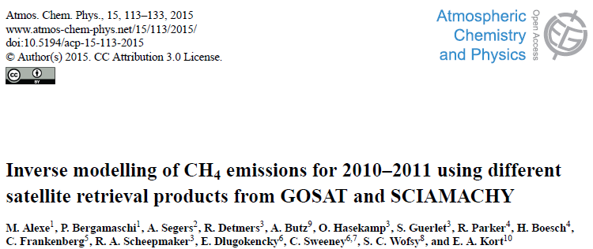
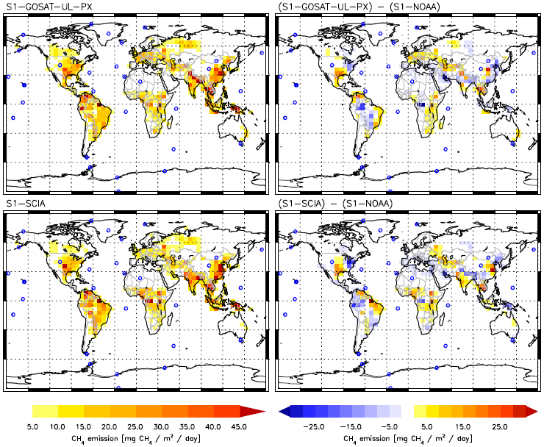
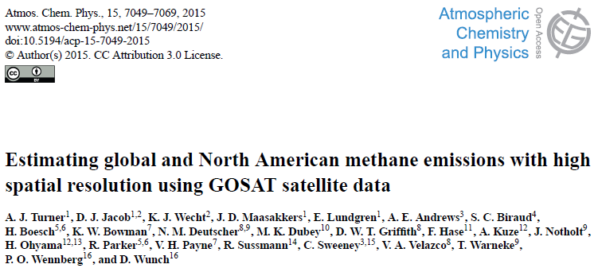
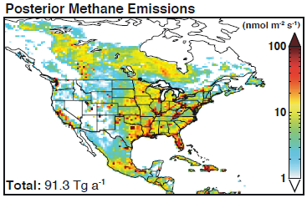
GHG-CCI: Recent Publications:
CH₄ sources/sinks (eg USA)
Alexe et al., 2015
Emission maps show overall good agreement among all satellite-based inversions
North America: significant redistribution of CH₄ emissions from North-East to South-Central United States
Turner et al., 2015
Inferred US anthropogenic methane source of 40.2–42.7 Tg/a (higher than EDGAR and EPA)

Slide 11
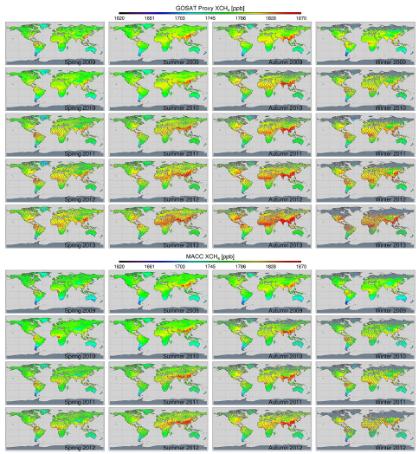
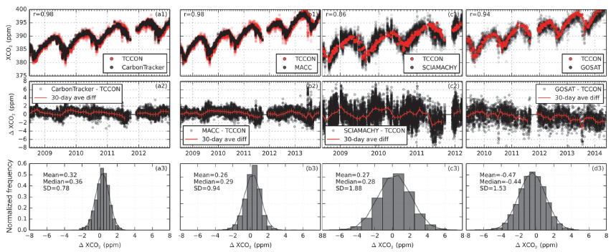
GHG-CCI: Recent Publications:
Model & TCCON comparisons
GOSAT
Parker et al., 2015
MACC
Kulawik et al., 2016

Slide 12
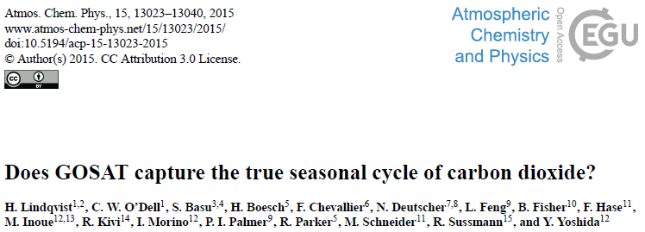
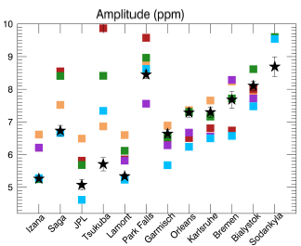
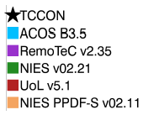
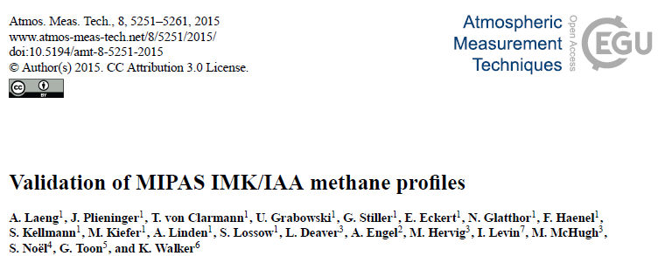
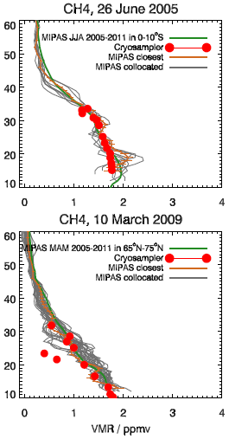
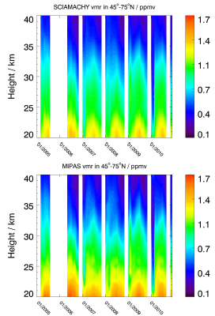
GHG-CCI: Recent Publications:
CO₂ seasonal cycle, MIPAS CH₄
Lindqvist et al., 2015
Model-to-model differences can be larger than GOSAT-to-model differences
GOSAT retrievals of the XCO₂ seasonal cycle may be sufficiently accurate to evaluate land surface models in regions with significant discrepancies between the models.
Laeng et al., 2015
Various comparisons including SCIAMACHY solar occultation (GHG-CCI)

Slide 13
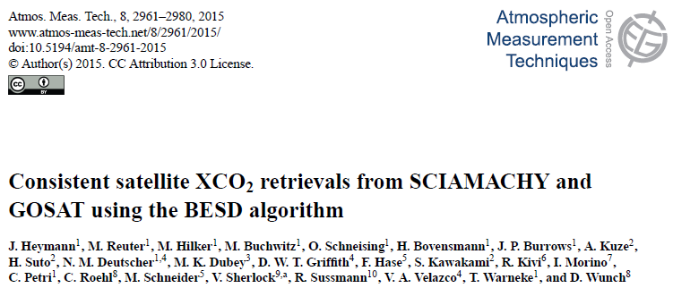
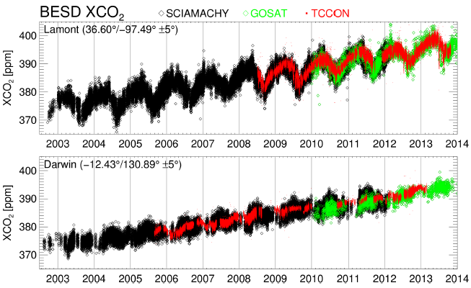
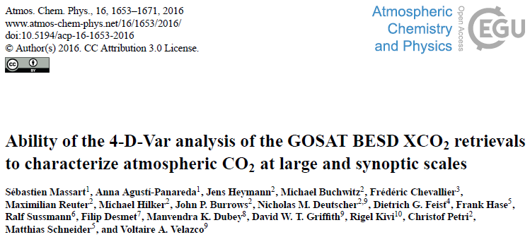
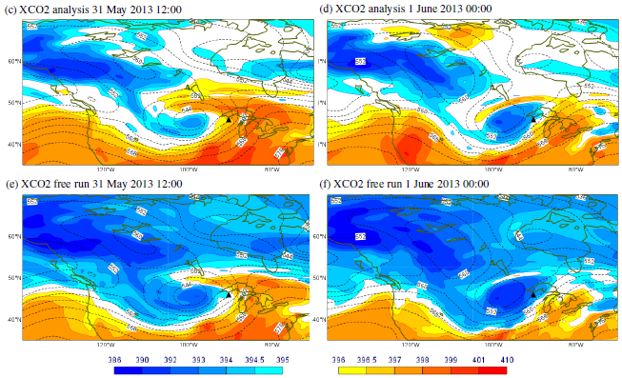
GHG-CCI: Recent Publications:
XCO₂ via BESD algorithm
Heymann et al., 2015
New GOSAT XCO₂ product (MACC project) generated with same BESD algorithm as used for SCIAMACHY (GHG-CCI, MACC)
Assessed and used at ECMWF
Massart et al., 2015

Slide 14
GHG-CCI: Data
New:
Feb. 2016:
CRDP#3

Slide 15
Data Set CRDP#3

Slide 16
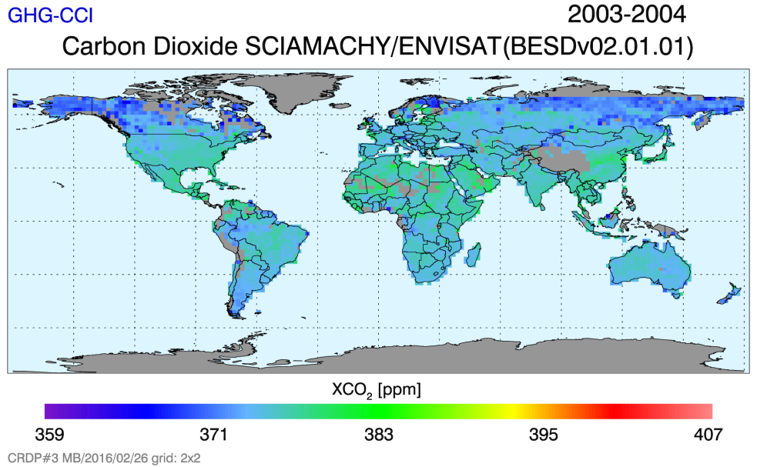
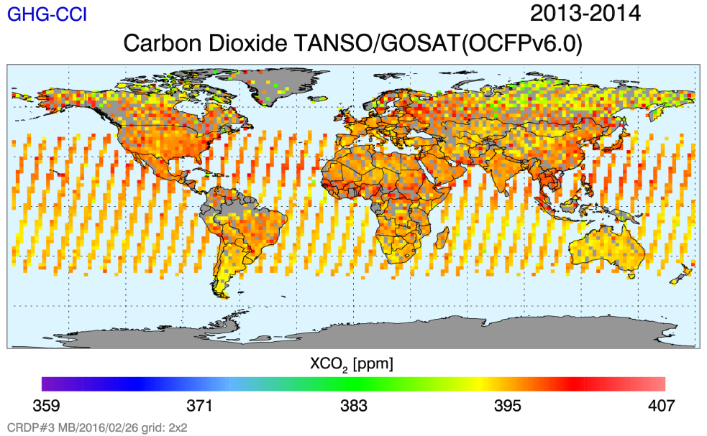
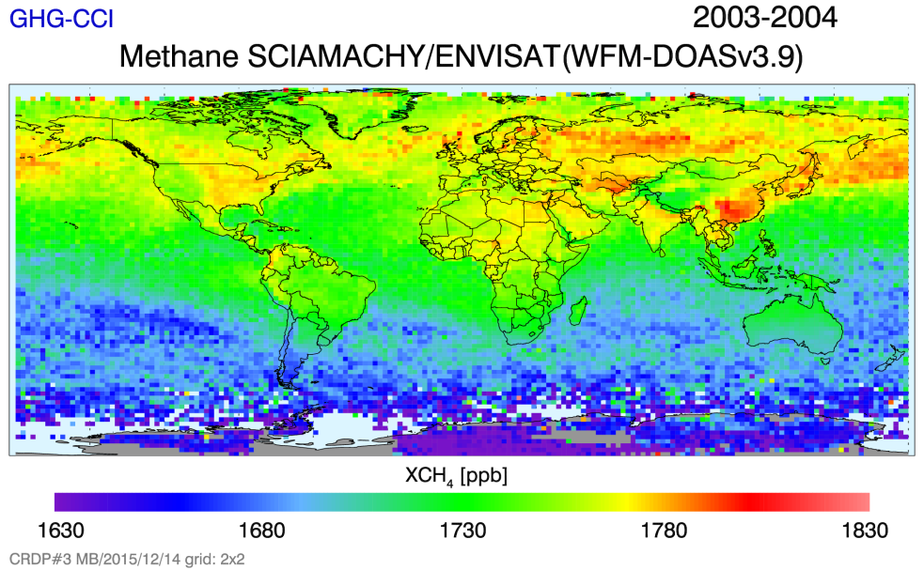
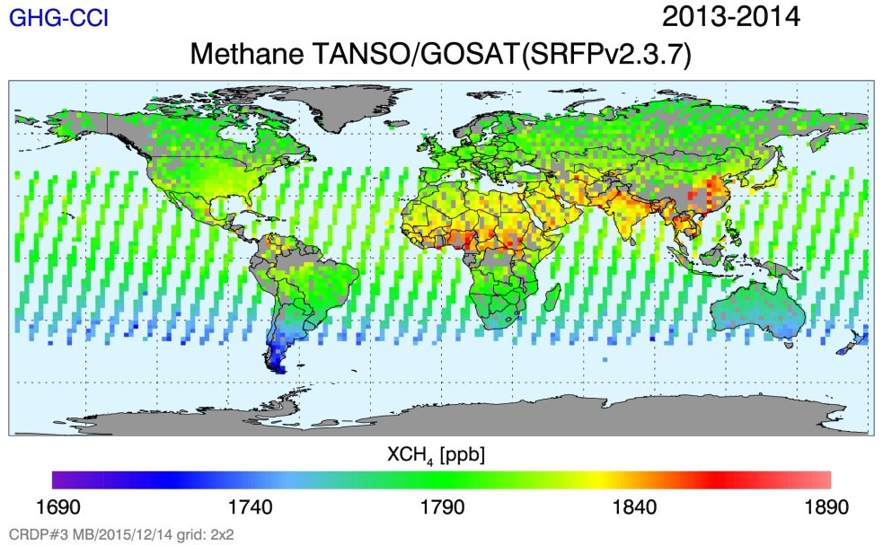
CRDP#3: XCO₂ & XCH₄

Slide 17
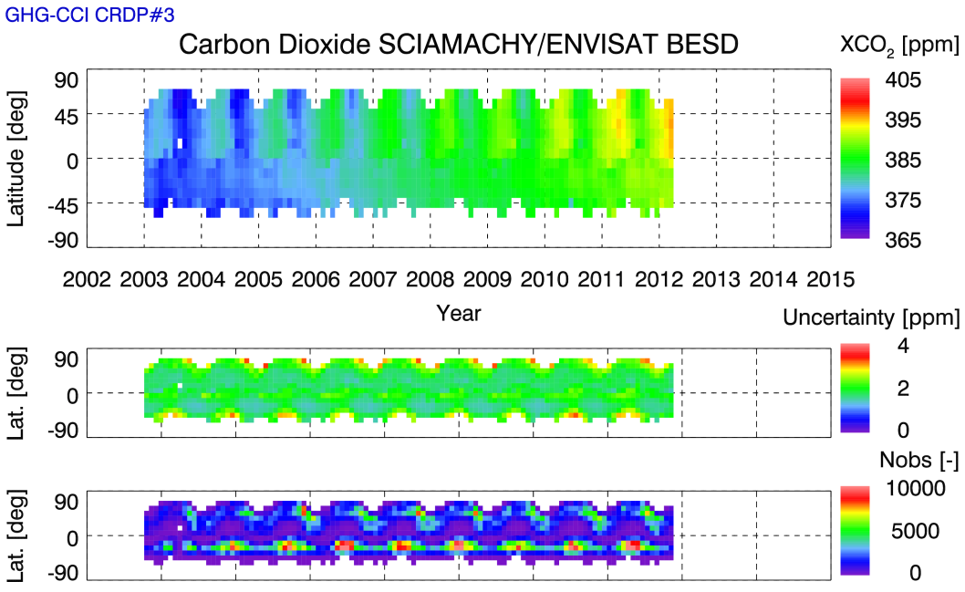
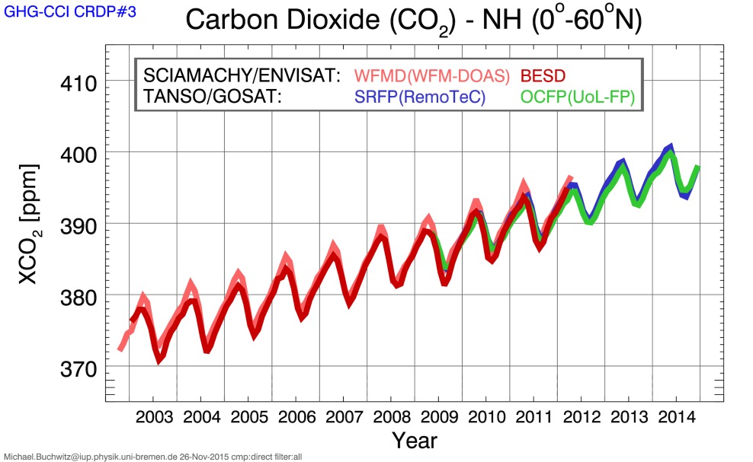
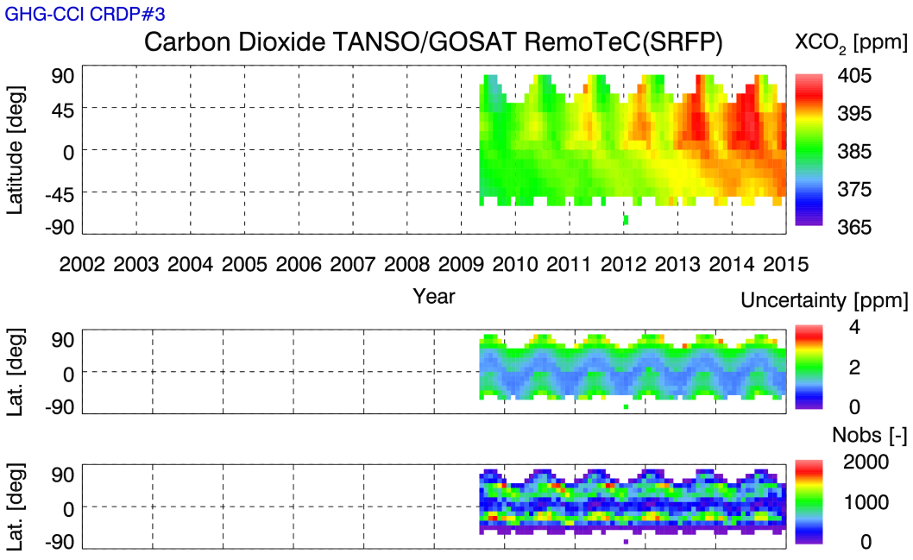
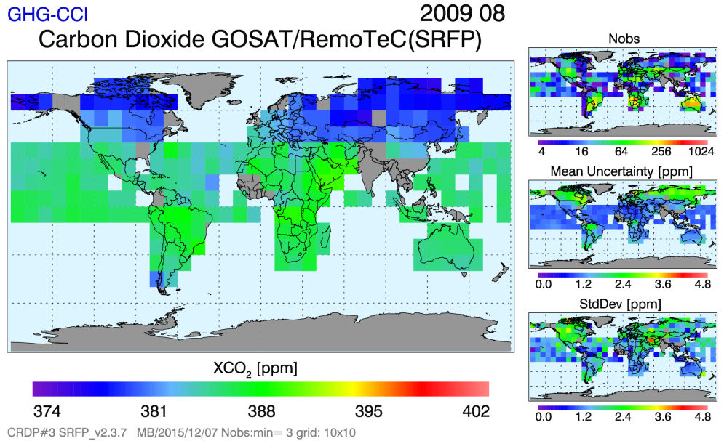
CRDP#3: XCO₂

Slide 18
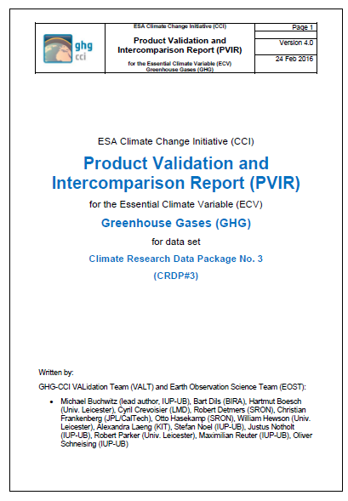
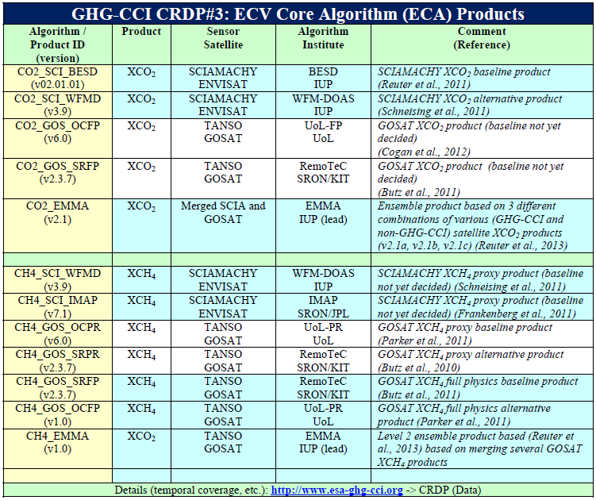
CRDP#3: Validation
PVIR v4
http://www.esa-ghg-cci.org/?q=webfm_send/300

Slide 19
GHG-CCI: Estimates of achieved data quality ^{(#)}: CRDP#3 XCO₂
Sensor | Algorithm | Random error [ppm] | Systematic error [ppm] | Stability ^{(§§)} [ppm/year] | Details (section)
SCIAMACHY on ENVISAT | BESD v02.01.01 | 2.1 1.9 2.0 1.9 | 0.41 - 0.66 0.39 0.42 0.4 – 0.8 | -0.03 +/- 0.10 -0.11 +/- 0.28 -0.04 +/- 0.33 -0.01 +/- 0.09 | VAL (Sect. 3) DP (6.1.1) EMMA (6.1.5) QC/QA (7.1)
SCIAMACHY on ENVISAT | WFMD v3.9 | 3.2 3.0 3.1 3.2 3.0 | 0.63 – 0.99 0.5 0.89 0.64 0.6 – 1.1 | 0.00 +/- 0.16 [0.01, 0.04] 0.14 +/- 0.29 0.27 +/- 0.46 0.01 +/- 0.10 | VAL (3) DP (6.1.2) DP (6.1.1) EMMA (6.1.5) QC/QA (7.1)
TANSO on GOSAT | OCFP v6.0 (UoL-FP) | 1.9 1.8 1.8 1.7 | 0.46 - 0.58 0.42 0.47 0.3 – 0.5 | -0.19 +/- 0.19 0.16 -0.19 +/- 0.17 -0.11 +/- 0.14 | VAL (3) DP (6.1.3) EMMA (6.1.5) QC/QA (7.1)
TANSO on GOSAT | SRFP v2.3.7 (RemoTeC) | 2.0 1.9 1.9 1.9 | 0.40 - 0.62 0.92 0.53 0.5 – 0.6 | 0.07 +/- 0.31 -0.015 0.07 +/- 0.28 -0.08 +/- 0.11 | VAL (3) DP (6.1.4) EMMA (6.1.5) QC/QA (7.1)
SCIAMACHY & GOSAT | EMMA v2.1a | 2.3 2.1 | 0.51 - 0.61 0.42 | -0.04 +/- 0.27 -0.07 +/- 0.33 | VAL (3) EMMA (6.1.5)
SCIAMACHY & GOSAT | EMMA v2.1b | 1.9 1.7 | 0.32 - 0.61 0.44 | -0.13 +/- 0.45 -0.10 +/- 0.22 | VAL (3) EMMA (6.1.5)
TANSO on GOSAT | EMMA v2.1c | 1.9 1.8 | 0.41 - 0.54 0.45 | -0.14 +/- 0.33 -0.06 +/- 0.22 | VAL (3) EMMA (6.1.5)
Required | G / B / T | < 1 / 3 / 8 - | < 0.2 / 0.3 / 0.5 < 1 | < 0.2 / 0.3 / 0.5 < 0.2 | /URD GHG-CCI v2/ /GCOS -154/
(#) As estimated (mostly) by comparison with ground-based TCCON observations neglecting TCCON accuracy (1-sigma) of 0.4 ppm Green numbers: at least URDv2 threshold requirement fulfilled; single values random and systematic errors are 1-sigma; (§§) Long-term drift only
PVIR v4

Slide 20
GHG-CCI CRDP#3: Comparison with GCOS Requirements
Variable^{(*)} | Resolution | Accuracy | Stability ^{(§§)}
XCO₂ | Temporal: GCOS: 4 hours Achieved: Days No existing nor any planned mission meets the GCOS temporal resolution requirement. Spatial: GCOS: 5-10 km Achieved^{($)}: 10 km ($) for GOSAT. SCIAMACHY: 30x60 km². URD: SCIAMACHY and GOSAT are useful to generate the ECV GHG. Note: GCOS requirements are target (maximum) requirements but URD requirements listed here are threshold (minumum) requirements. | GCOS: < 1 ppm URD^{(#)}: < 0.5 ppm Achieved^{(#)}: 0.3-0.9 ppm^{(?)} (?) Depending on sensor, time period and assessment method | GCOS: < 0.2 ppm/yr URD: < 0.5 ppm/yr Achieved: < 0.2 ppm/yr⁽⁺⁾ (+) Derived trends not significant
XCH₄ |  | GCOS: < 10 ppb URD^{(#)}: < 10 ppb Achieved^{(#)}: 3-7 ppb^{(§)} (§) for GOSAT; for SCIAMACHY 7-17 ppb depending on time period (degradation after Oct. 2005) | GCOS: < 2 ppb/yr URD: < 10 ppb/yr Achieved: < 1-4 ppb/yr^{(!) (§§)} (!) Depending on sensor (GOSAT < 1 ppm). Derived trends mostly not significant but note (§§)
 |  | (#) Relative accuracy (i.e., excluding a possible constant global offset) (§§) Stability quantifies only long-term drift and therefore does not capture certain features due to detector issues as observed when analyzing SCIAMACHY data (e.g., around mid 2010) Estimated by comparison with TCCON ground-based observations; TCCON accuracy (1-sigma): 0.4 ppm for XCO₂ and 3.5 ppb for XCH₄
(*) Requirements for column-averaged mole fractions (= air column normalized vertical GHG columns) as required by URD; it is assumed here that this corresponds to GCOS variables „Tropospheric CO₂ column“ and „Tropospheric CH₄ column“
References: Requirements for ECV Greenhouse Gases (GHG): GCOS-154: „SYSTEMATIC OBSERVATION REQUIREMENTS FOR SATELLITE-BASED DATA PRODUCTS FOR CLIMATE“ URD: “GHG-CCI User Requirements Document”, v2.0 Definition: ECV GHG (GCOS-154): Product A.8.1: Retrievals of CO₂ and CH₄ of sufficient quality to estimate regional sources and sinks
PVIR v4

Slide 21
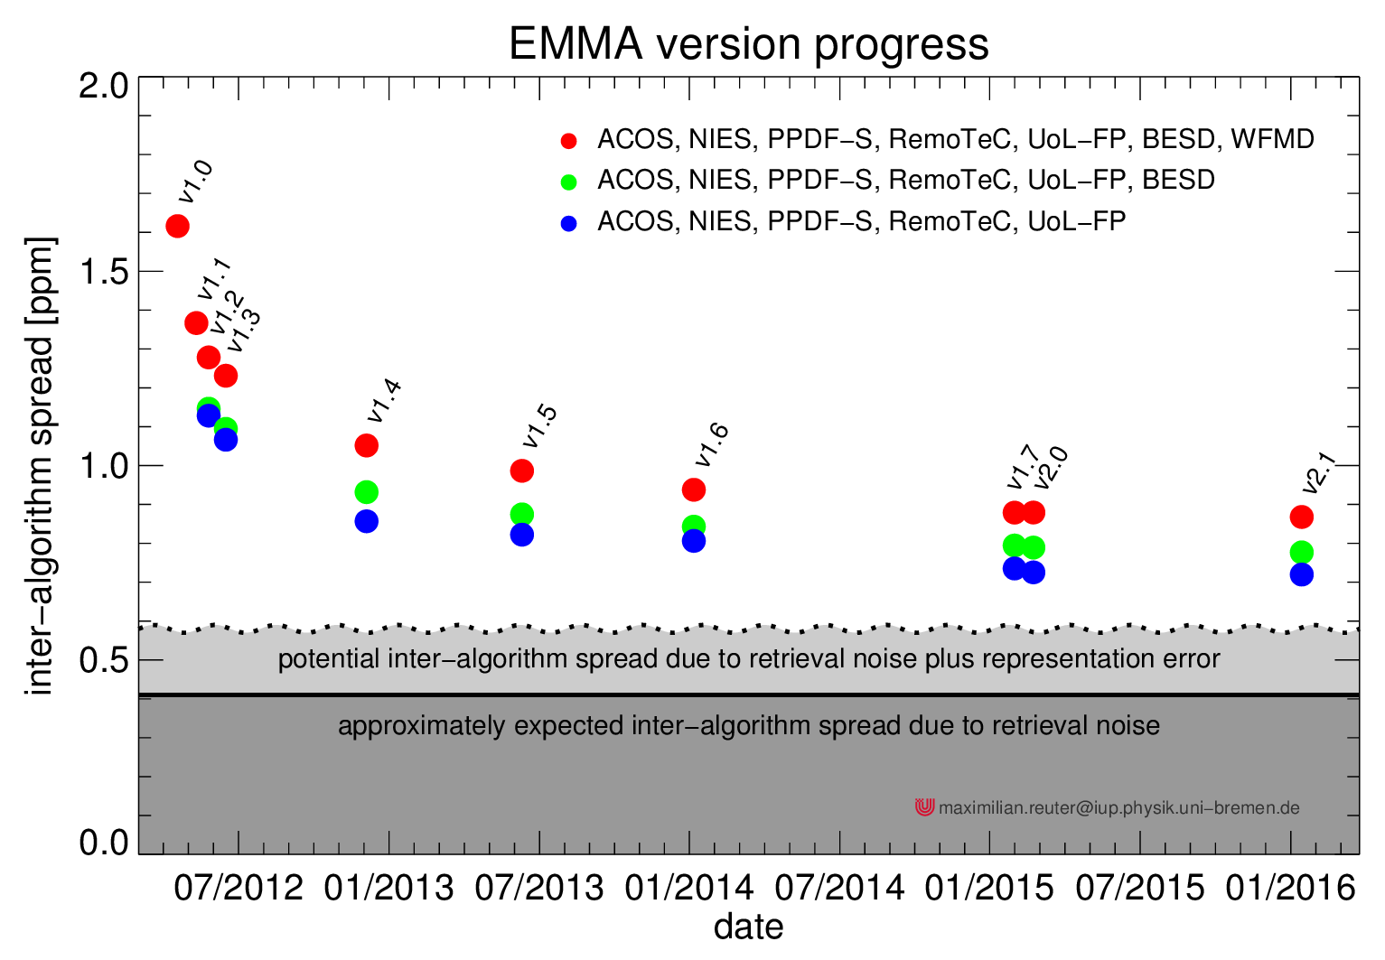
Improvement history XCO₂
via EMsemble Median Algorithm (EMMA, Reuter et al., 2013)
CRDP3

Slide 22
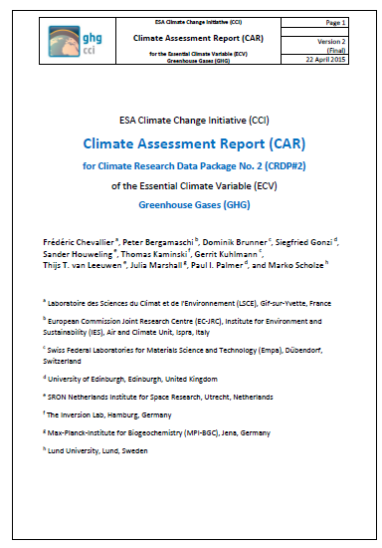
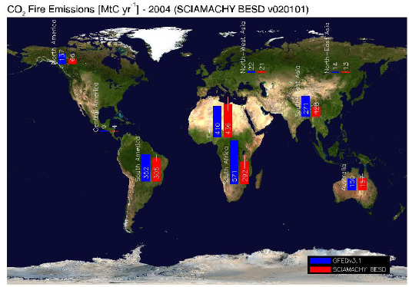
GHG-CCI: Cross-ECV activities
Funded GHG-CCI related activities:
Via „optional WP“: Aerosol induced Biases in Greenhouse gas Observations from satellite (ABGO) (lead Empa)
So far using „external“ aerosol information primarily from AERONET
Ongoing/future: Use of Aerosol-CCI
CARv2
http://www.esa-ghg-cci.org/?q=webfm_send/256
Via „Living Planet Fellowship - Climate Change Initiative“: CARBOn dioxide emissions from FIRES (CARBOFIRES) (J. Heymann, IUP-Bremen)
So far „external“ fire & fire-CO₂ a priori emission information from GFED & CarbonTracker, …
Ongoing/future: Use of Fire-CCI
J. Heymann, CARBOFIRES MidTermReport

Slide 23
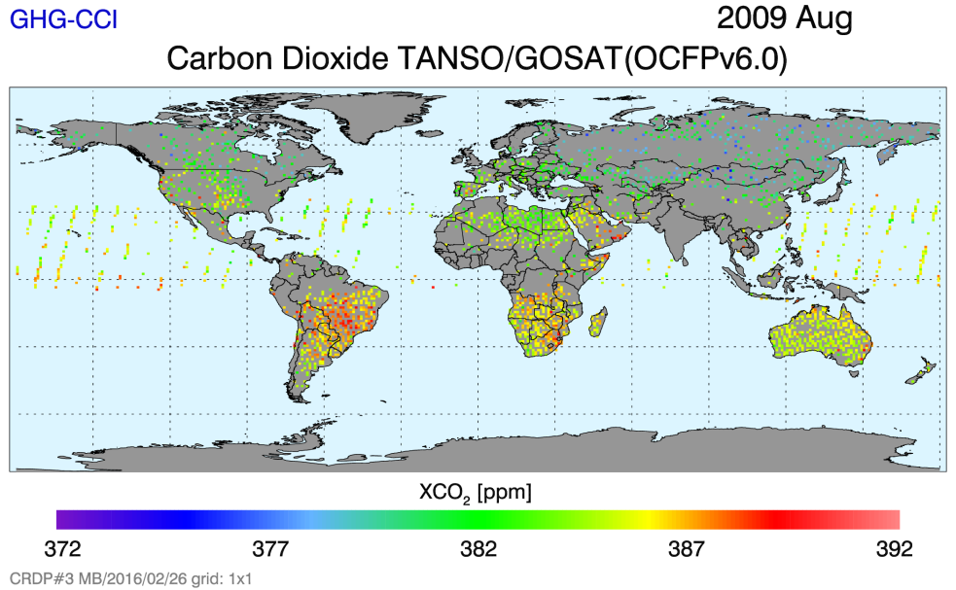
GHG-CCI: Obs4MIPs
Monthly, 1ºx1º
Monthly, 5ºx5º
Monthly 1ºx1º -> sparse & noisy -> we started with monthly 5ºx5º
Done:
Proposal:
Data Set Forms -> accepted
First test data set
XCO₂, Monthly, 5ºx5º
Merged SCIA + GOSAT
CRDP2 (2003 – 2013)
CF names XCO₂ & XCH₄
ToDo:
Docu: Required TNs
First „final“ data sets:
Based on CRDP3 (2003 – 2014)
XCO₂ and XCH₄
In cooperation with Veronika Eyring (chair CMIP panel)

Slide 24
GHG-CCI: Last year activities (March 2016 – Feb 2017)
Final reprocessing to generate CRDP#4:
Improved core products (SCIAMACHY and GOSAT XCO₂ and XCH₄)
Improved „additional constraints products“ (IASI CO₂ and CH₄, …)
Extended time series: end of 2002 – end of 2015
…
Planned release: Feb. 2017 (incl. validation and initial user assessment)
Other activites:
Peer-reviewed publications (e.g., for RSE special issue on CCI ECV data sets)
First „final“ Obs4MIPs XCO₂ and XCH₄ products
Various other …

Slide 25
After ongoing GHG-CCI project ?
So far so (very) good …
GCOS requirements
Future funding for needed R&D?
Risk of little or no funding for existing ECVs.
GHG
GHG & R&D
CCI
User

Slide 26
Thank you very much for your attention !
The GHG-CCI team

