Slide 1
Climate Modelling User Group – Current and Future work
Amy Doherty and Jack Darch
August 2026
Notes:
V quick intro

Slide 2













What is CMUG?
The Climate Modelling User Group: a project in ESA’s Climate Change Initiative
Notes:
Partners – climate modelling expertise from across Europe

Slide 3

CMUG Aims
1. Support integration within the CCI programme
2. Foster exploitation of satellite-derived ECVs
3. Assess quality and impact of CCI ECVs
Notes:
Longer talk through each

Slide 4
CMUG Activities
Science studies to assess quality and impact of CCI data
Engage with climate science community
Integration across the CCI programme
CCI ECV dataset user requirements
Advance ECV uncertainty characterisation
Build links with the climate modelling community
Promote CCI data use in climate models
Support model evaluation with CCI data
Provide feedback to CCI teams
Improve access to ECV datasets through tools and databases
Publish scientific papers
Gap analysis
Notes:
Who we interact with:
CCI ECV Projects
EO bodies
Tools
Climate modelling – NMHS, CMIP, CORDEX
Climate monitoring
These fall under : studies, comms, tools

Slide 5


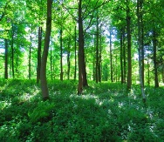

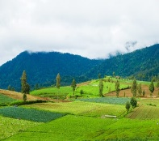




CMUG – Scientific Studies
WP5.1 Machine Learning for Process Understanding
WP5.6 Snow Dynamics
WP5.2 Vegetation Phenology
WP5.7 Ice Sheets
WP5.3 Land Cover
WP5.8 Machine Learning for Wetland Methane Emissions
WP5.4 Ocean Biogeochemistry
WP5.9 Vegetation and Hydrometeorology
WP5.5 Clouds and Aerosols
Notes:
Optional studies extending all of these to a second phase (apart from 5.8) have now been kicked off.

Slide 6
CMUG – Science Studies
Machine learning to advance climate model evaluation and process understanding – Lisa Bock, DLR
Impacts and evaluation of vegetation phenology changes on observed and modelled land-atmosphere processes – Daniele Peano, CMCC
Impact of integrating CCI LC data in the ISBA land surface model – Jean-Christophe Calvet, Météo France
Seasonal predictability of ocean biogeochemistry and potential benefits of ESA CCI data assimilation – David Ford, Met Office
Cloud and aerosol analysis study, Jeronimo Escribano, BSC / Kirsti Salonen, ECMWF
Snow dynamics impacts on temperate/high latitude climate – Amelie Cuynet, IPSL
Atmospheric drivers and feedback processes affecting the Greenland and Antarctic ice-sheets in observations and regional models – Ulrika Willen, SMHI
Using machine learning to evaluate and understand our capability to model tropical wetland methane emissions – Rob Parker, U. Leicester/NCEO (D.01.04)
Assessment and evaluation of the role of vegetation on hydrometeorological processes in CMIP models – Daniele Peano, CMCC
Notes:
Real summary of each – Kirsti Friday morning

Slide 7
CMUG – Other activities
CCI contributions to ESMValTool
  Axel Lauer, DLR
Climate community requirements collection and analysis
  Amy Doherty, Met Office
Foresight Report
  Richard Jones, Met Office
CMUG support to the future evolution of obs4MIPs
  Amy Doherty, Met Office / Alison Waterfall, CEDA / Claire Bulgin, U. Reading
Communications and outreach – Hannah Findley / Jack Darch, Met Office
  Newsletter
  Climate Science Working Group
  Website: Climate Modelling User Group (CMUG)

Slide 8











CMUG – ESMValTool development
The Earth System Model Evaluation Tool (ESMValTool):
open-source code with extensive documentation
community-developed
diagnostics and performance metrics
https://esmvaltool.org/
CMUG activities in support of ESMValTool:
recipes and diagnostics using ESA CCI datasets enabling tailored evaluation of ESMs
explore the use of observational uncertainty characteristics for model evaluation
Notes:
CMUG adds diagnostics and metrics for CCI datasets into ESMValTool to make them easier for modellers to use. Also trying to improve and facilitate use of uncertainties supplied by CCI projects through ESMValTool – treatment of uncertainties needs work

Slide 9
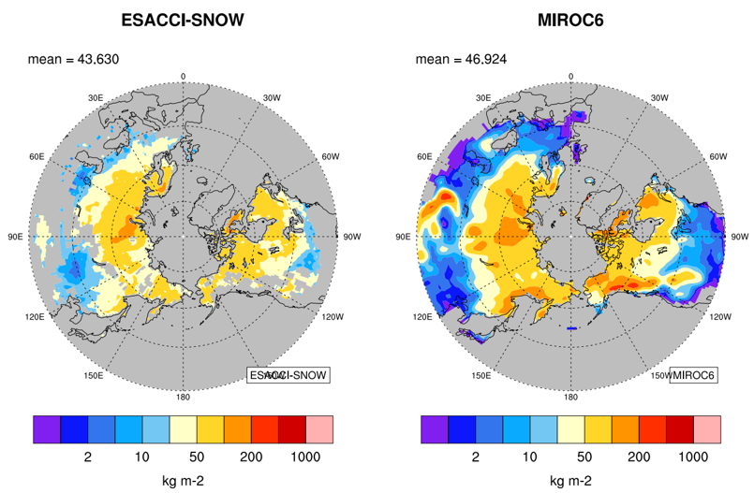
CMUG – Science Studies
Machine Learning for
Process Understanding
ML-based causal analysis is being used to identify the drivers of cloud properties and develop process-oriented climate model evaluation methods.
The framework is being extended to the ICON-XPP climate model to test whether observed cloud-process relationships can be reproduced in simulations.
New ESMValTool diagnostics using ESA CCI Snow and Permafrost datasets reveal both strengths and biases in CMIP6 model simulations.
For example, the MIROC6 model shown captures the basic features of the geographical pattern and amplitude but tends to produce snow too far south.
Comparison of the 5-year average (2009-2014) snow water equivalent (in kg m-2) for December-January-February from ESACCI-SNOW (left) with the historical simulation from the CMIP6 model MIROC6 (right). Glaciated areas have been masked out.
Notes:
Cloud classes derived from high resolution satellite obs and coarse resolution climate models using a deep neural network for cloud MODIS pixels.
These classes train a random forest regression model to produce cloud class distributions

Slide 10
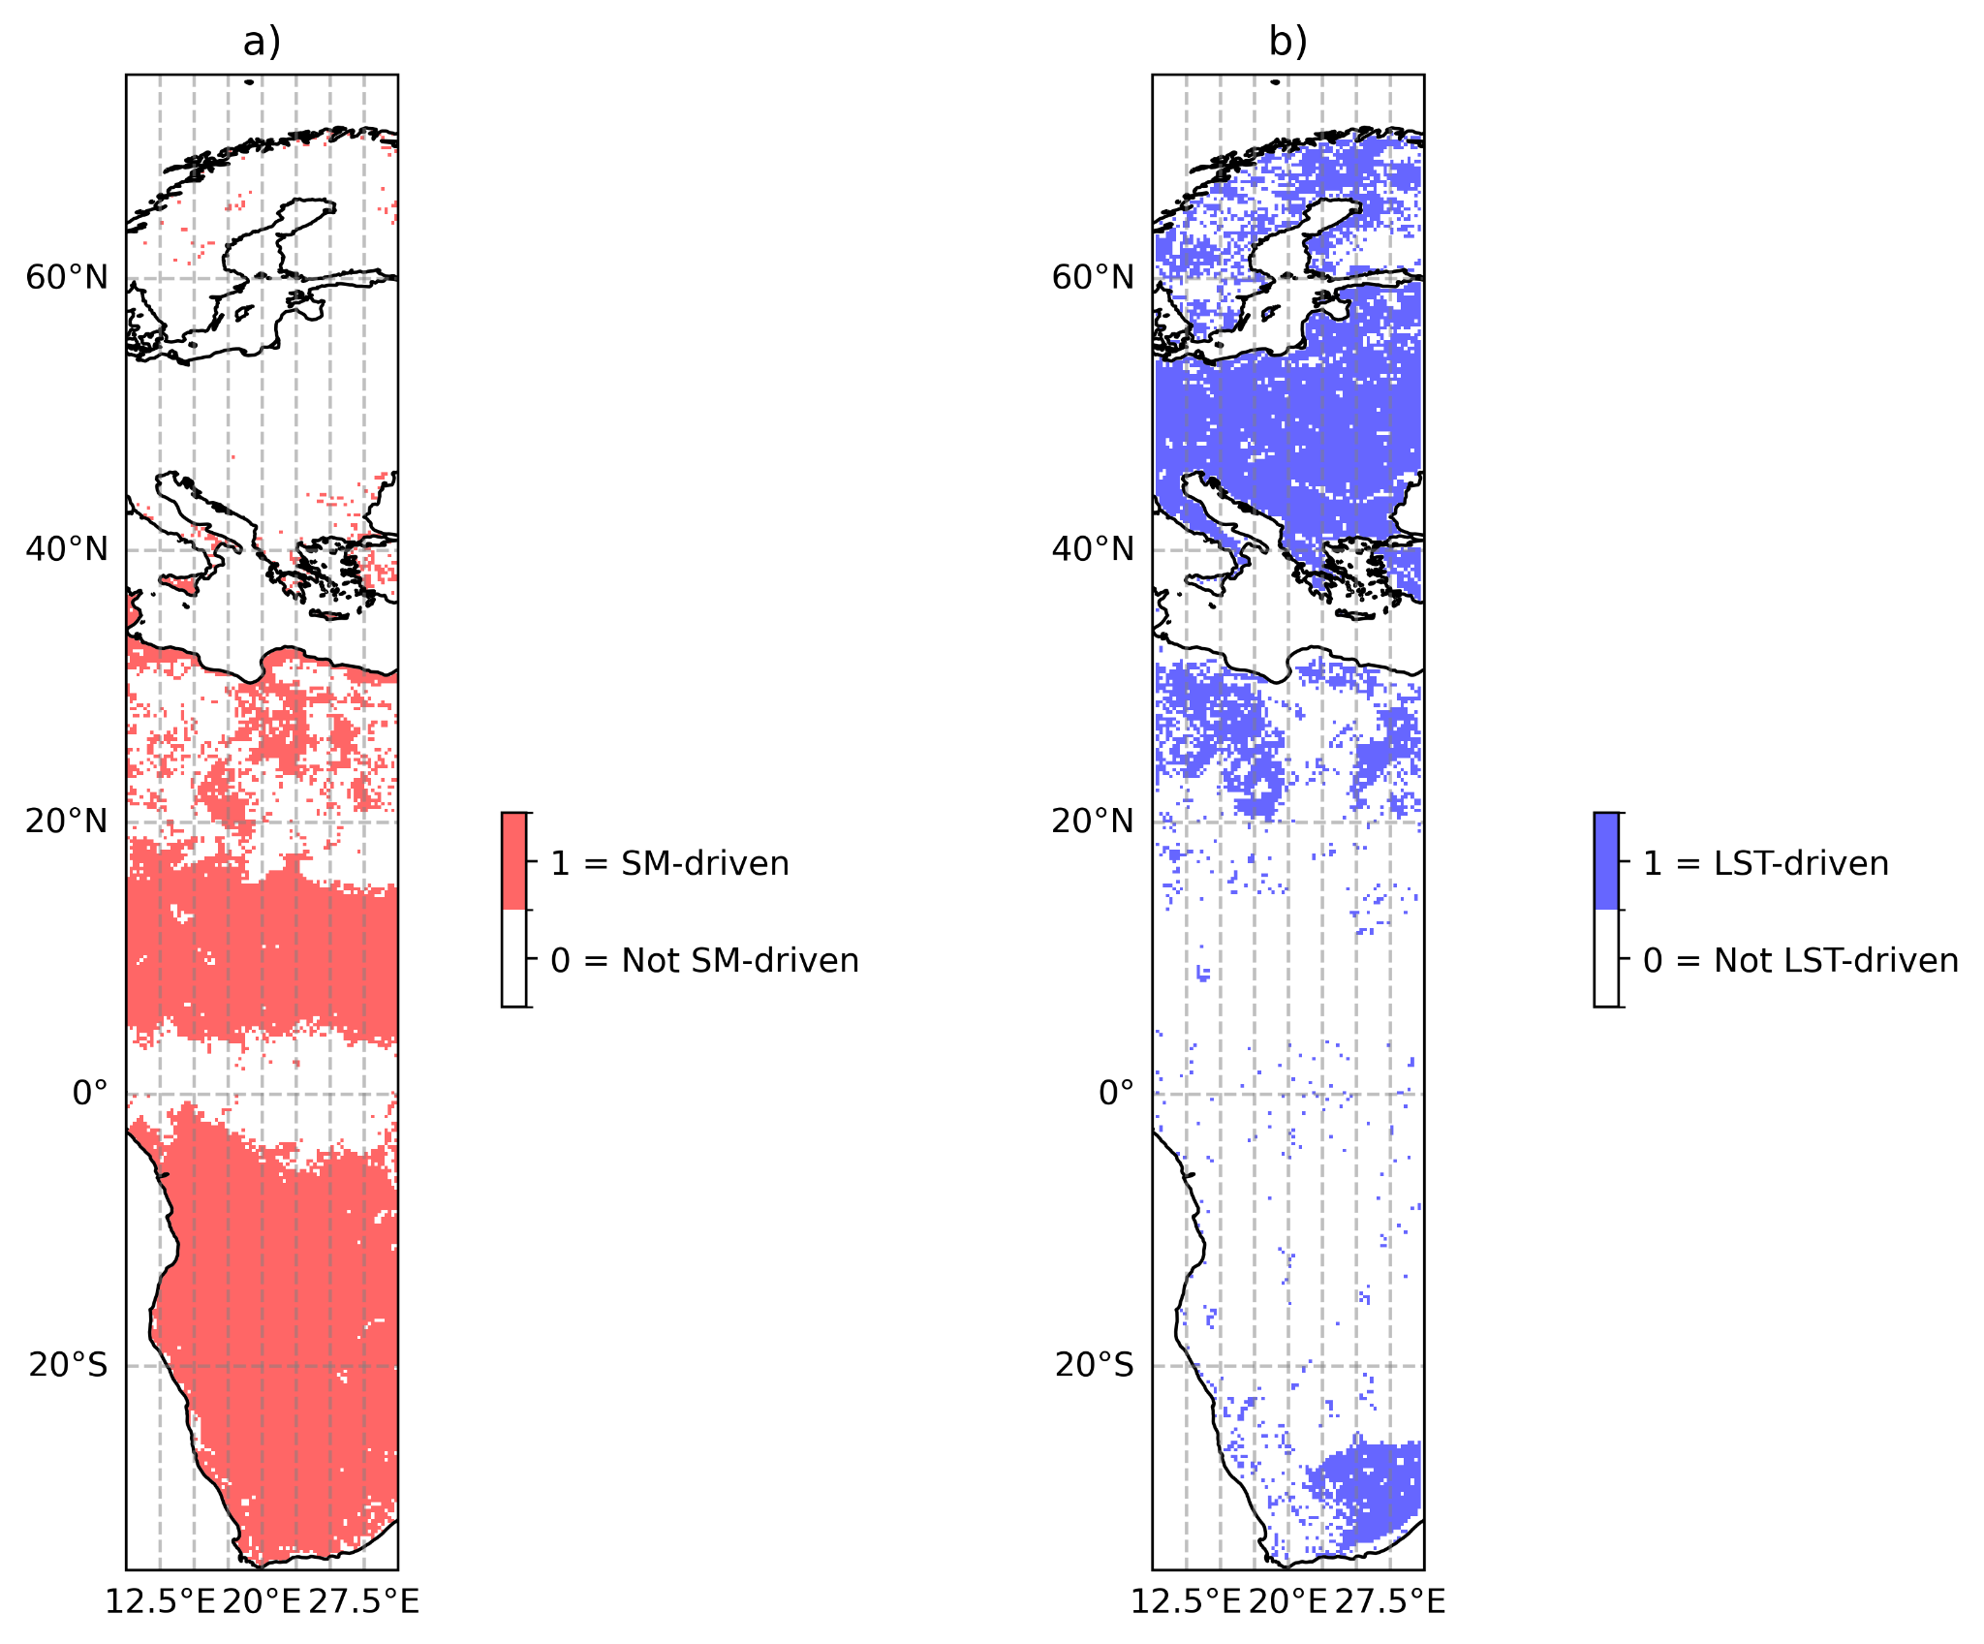
CMUG – Science Studies
Phenology
CCI Leaf Area Index (LAI) data is processed into continuous, smoothed time series suitable for phenology analysis
Processed LAI data is compared with temperature and soil moisture observations to investigate the environmental controls on vegetation growth.
Correlations, time-lag relationships, and climatological thresholds are used to identify regions where vegetation phenology is primarily driven by water availability or temperature. Water-driven phenology is concentrated in semi-arid regions; temperature-driven phenology dominates many temperate and boreal regions
Combining LAI, soil moisture and land surface temperature supports evaluation of vegetation processes in land surface models
Regions where vegetation phenology is primarily driven by (a) soil moisture and (b) land surface temperature. Classification is based on at least two of three indicators: favourable climatological conditions, a positive correlation with Leaf Area Index (LAI), and a positive lagged relationship in which changes in soil moisture or temperature precede vegetation growth.
Notes:
Work continues plus a hydrometeorology study from Daniele

Slide 11
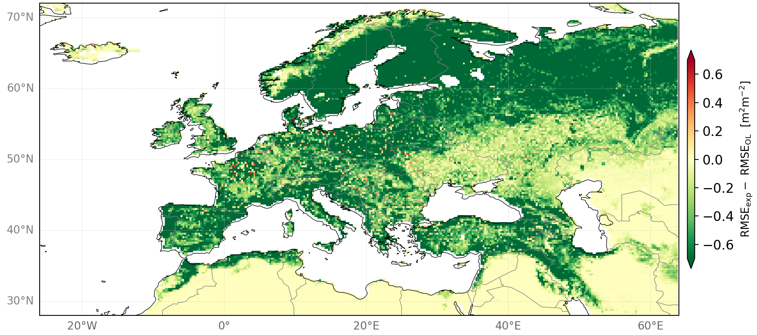
CMUG – Science Studies
Land Cover
The study assesses the impact of assimilating CCI Leaf Area Index (LAI) data within the LDAS-Monde/ISBA land surface modelling system
The new CCI-LAI product shows promise for land-surface data assimilation, with ongoing work focused on refining the conversion from effective to true LAI and evaluating performance against established datasets.
Assimilation of established satellite LAI products, such as GEOV2-AVHRR, reduces model error relative to the open-loop simulation, demonstrating the value of vegetation observations for improving land-surface analyses.
Difference in Root Mean Square Error (RMSE) between the DA_90_AVHRR assimilation experiment and the open-loop simulation over Europe. Assimilation of GEOV2-AVHRR Leaf Area Index (LAI) observations reduces model error across much of the domain, demonstrating the benefits of incorporating satellite vegetation information into land-surface analyses.

Slide 12
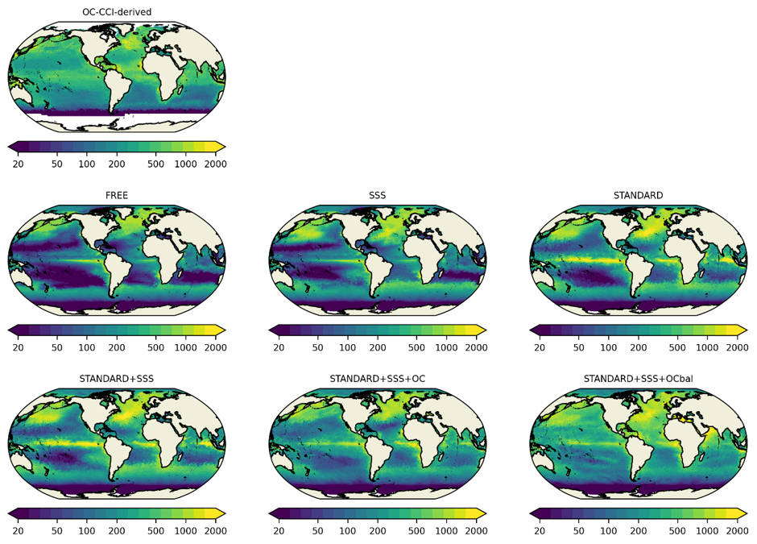
CMUG – Science Studies
Ocean Biogeochemistry
ESA CCI ocean physics and biogeochemistry products demonstrate clear potential to influence and constrain global ocean biogeochemical reanalyses.
SST, Sea Surface Salinity, Sea Level, Sea Ice and Ocean Colour CCI-ECV datasets were assimilated.
Both the Met Office and BSC ocean biogeochemical reanalysis systems show measurable responses to assimilated ECVs, highlighting the importance of multivariate and subsurface updates for maximising the information gained from observations.
Monthly mean column-integrated primary production for June 2019 from each MO run and the BICEP product derived from OC-CCI data.

Slide 13
CMUG – Science Studies
Clouds and Aerosols
ESMValTool has been extended to evaluate ECMWF and BSC data assimilation experiments using CCI aerosol and cloud products.
Assimilation experiments provide new insight into aerosol, cloud and dust processes, supporting targeted model and observational product development.
Dust assimilation experiments improve agreement between modelled dust optical depth and ESA-CCI observations, demonstrating the value of CCI aerosol products for model evaluation and assimilation.
Evaluation of the BSC MONARCH/LETKF coupled model dust assimilation using ESMValTool, comparing control and assimilated simulations against ESA-CCI dust optical depth observations.

Slide 14
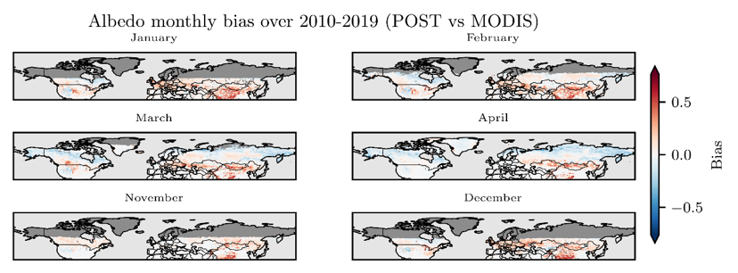
CMUG – Science Studies
Snow Dynamics
CCI Snow (SCFG, SCFV and SWE) and MODIS albedo products were used to optimise vegetation-dependent snow cover fraction and snow albedo processes in the ORCHIDEE Land Surface Model
New vegetation-dependent snow parameterisations improve representation of winter snow cover and surface albedo by accounting for differences between forests, grasslands and other vegetation types
Compared with the pre-optimised (PRIOR) configuration, the optimised (POST) configuration reduces albedo errors across many regions and vegetation types, although remaining biases indicate further work is needed to better represent snow cover and snow–vegetation interactions, particularly in boreal forest environments
Pan-Arctic monthly albedo bias over 2010-2019 (POST minus MODIS observations) showing the impact of the optimised snow parameterisation on surface reflectivity across northern high-latitude regions.

Slide 15
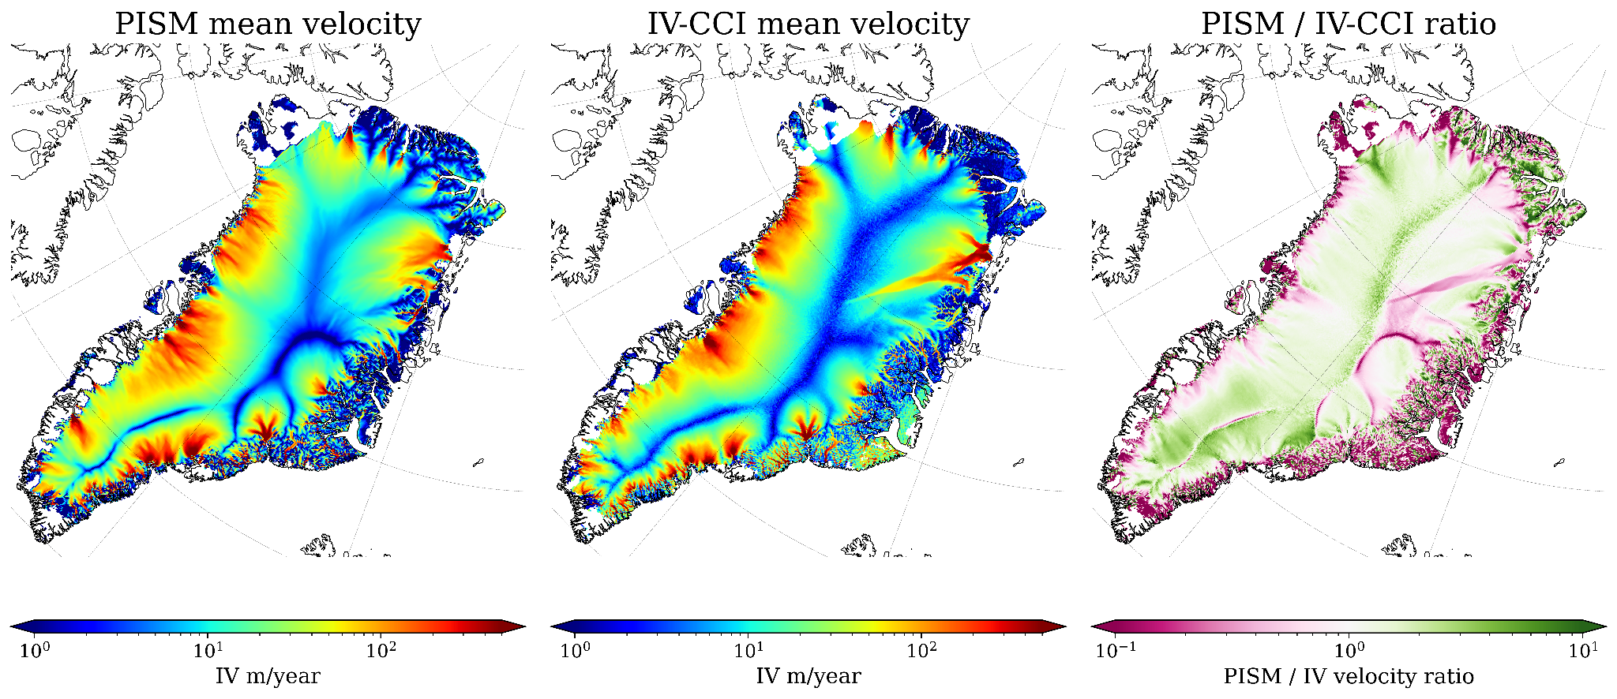
CMUG – Science Studies
Ice Sheets
ESA CCI ice-sheet products (Ice Velocity, Surface Elevation Change and Gravitational Mass Balance) provide independent observations for evaluating the coupled EC-Earth–PISM climate–ice-sheet model.
Comparisons with CCI observations show that the model captures the broad structure of Greenland ice flow, including the contrast between the slow-moving interior and fast-flowing outlet glaciers.
Regional biases remain in ice velocity, surface elevation change and mass loss
Comparison of Greenland Ice Sheet surface velocity from the EC-Earth–PISM model and the ESA CCI Ice Velocity product. The model reproduces the large-scale pattern of ice flow but shows notable regional differences

Slide 16
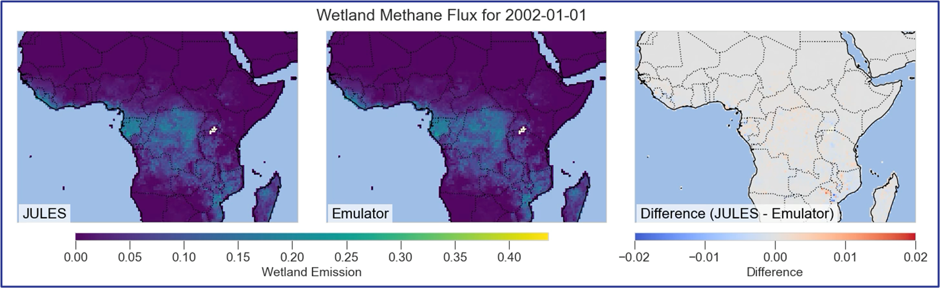
CMUG – Science Studies
Machine Learning for Wetland Methane Emissions
Current ensembles of JULES simulations with different driving data, temperature dependency, vegetation and
wetland masks show massively different methane fluxes. This Study aims to address this by:
  developing an emulator for JULES wetland methane,
  using its explainability to show which factors matter in the model,
  drive the emulator with CCI Earth Observation data to generate wetland fluxes
  compare those to a methane inversions performed on GOSAT/TROPOMI ESA CCI data
Results:
  The emulator performs
  well compared to JULES for
  wetland methane emissions,
  the only minor differences
  are on the very edges
  of wetland areas
Work is ongoing towards a
Digital Twin

Slide 17
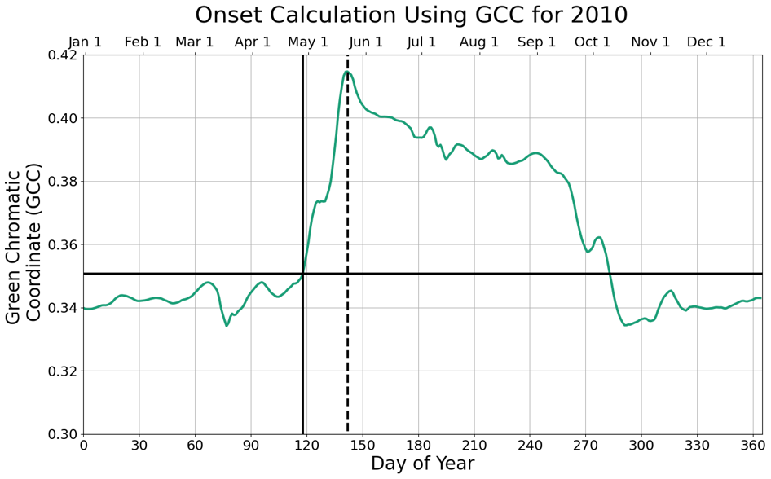
CMUG – Science Studies
Assessment and evaluation of the role of vegetation on hydrometeorological processes in CMIP models
ESA CCI Leaf Area Index, Soil Moisture, Water Vapour and Land Cover products were used to investigate links between vegetation phenology and hydrometeorological processes
Vegetation onset derived from CCI LAI and PhenoCam greenness observations using a threshold-based approach to identify the start of the growing season
ESMValTool diagnostic under development to compare phenology metrics across observations and CMIP6 models and assess relationships with soil moisture and atmospheric moisture
Illustration of the vegetation onset methodology, showing how the start of the growing season is identified from a greenness time series using a dynamic threshold based on annual minimum and maximum conditions.
Notes:
Work continues plus a hydrometeorology study from Daniele

