Slide 1
An overview of CMIP and CORDEX and a potential role for satellite LST
Thursday 29th September, LST User Workshop 2022
Eleanor O’Rourke, Director, CMIP International Project Office

Slide 2
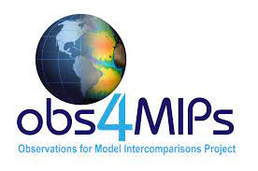
The World Climate Research Programme landscape
Earth System Modelling and Observations (ESMO)
Policy makers
Other WCRP modelling & observation activities
ESMO SSG
ESMO IPO
Funding agencies
WGCM
WCRP secretariat
Adaptation planning
CMIP Panel
Experimental design and associated requirements
WIP Panel
Data infrastructure
Core projects
CMIP IPO
Climate services
Lighthouse activities
Forcing dataset providers
MIPs
Modelling Centres
Impact modelling
WCRP Academy
Data nodes
New data technologies
Regional Information for Society (RIfS)
CORDEX IPO

Slide 3
CMIP: Short history and overview
CMIP started in 1995 driven by the Working Group on Coupled Modelling (WGCM) of the World Climate Research Programme (WCRP).
CMIP’s objective is to understand past, present and future climate changes arising from natural, unforced variability or in response to changes in radiative forcing in a multi-model context.
CMIP has a dual role: a scientific enterprise driving climate modelling research and development and policy support.
An important goal of CMIP is to make the multi-model output publicly available in a standardized format to allow those outside the modelling centres to utilise the CMIP output and facilitate downstream users.

Slide 4
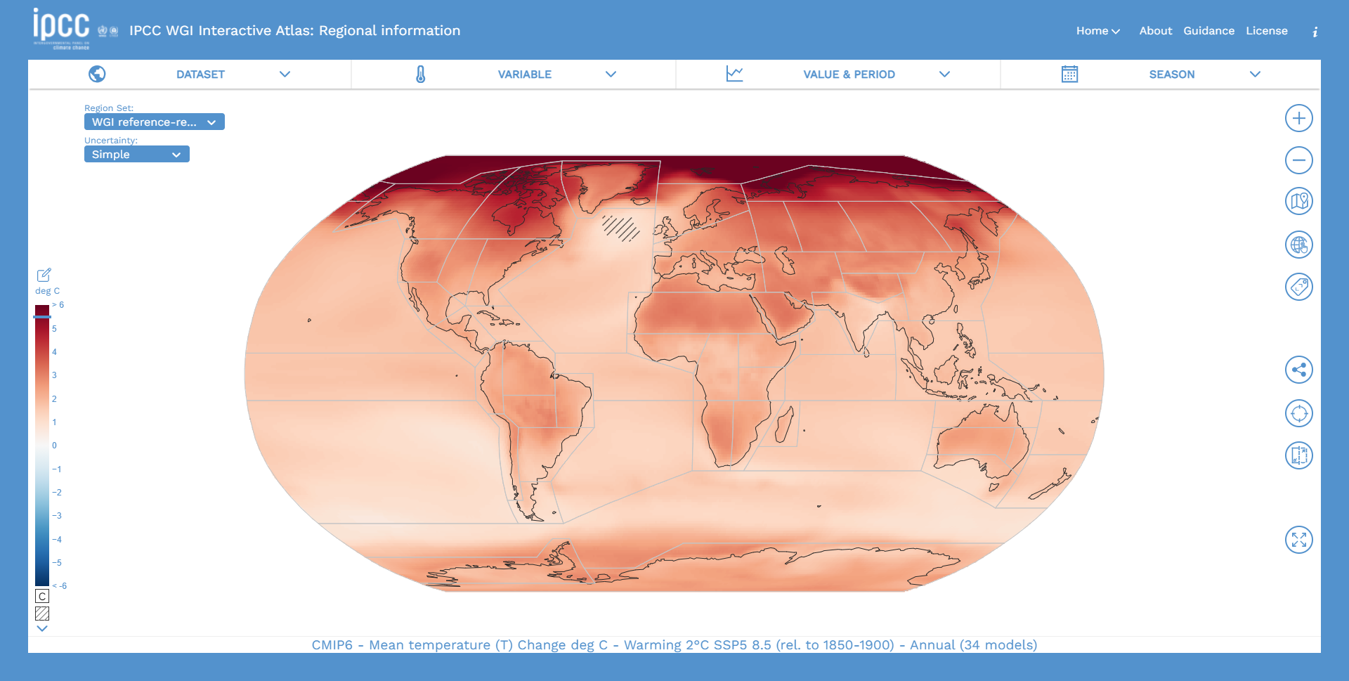
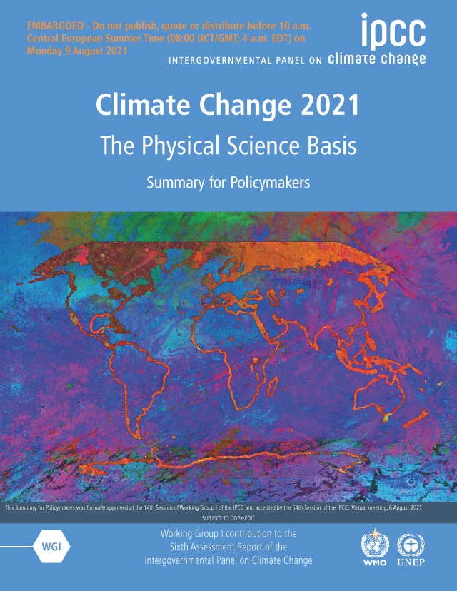
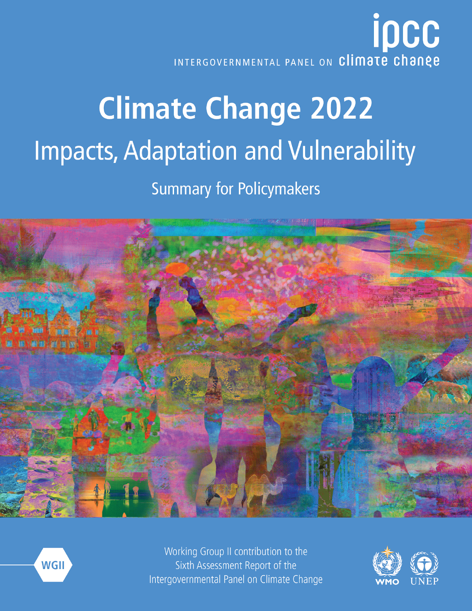
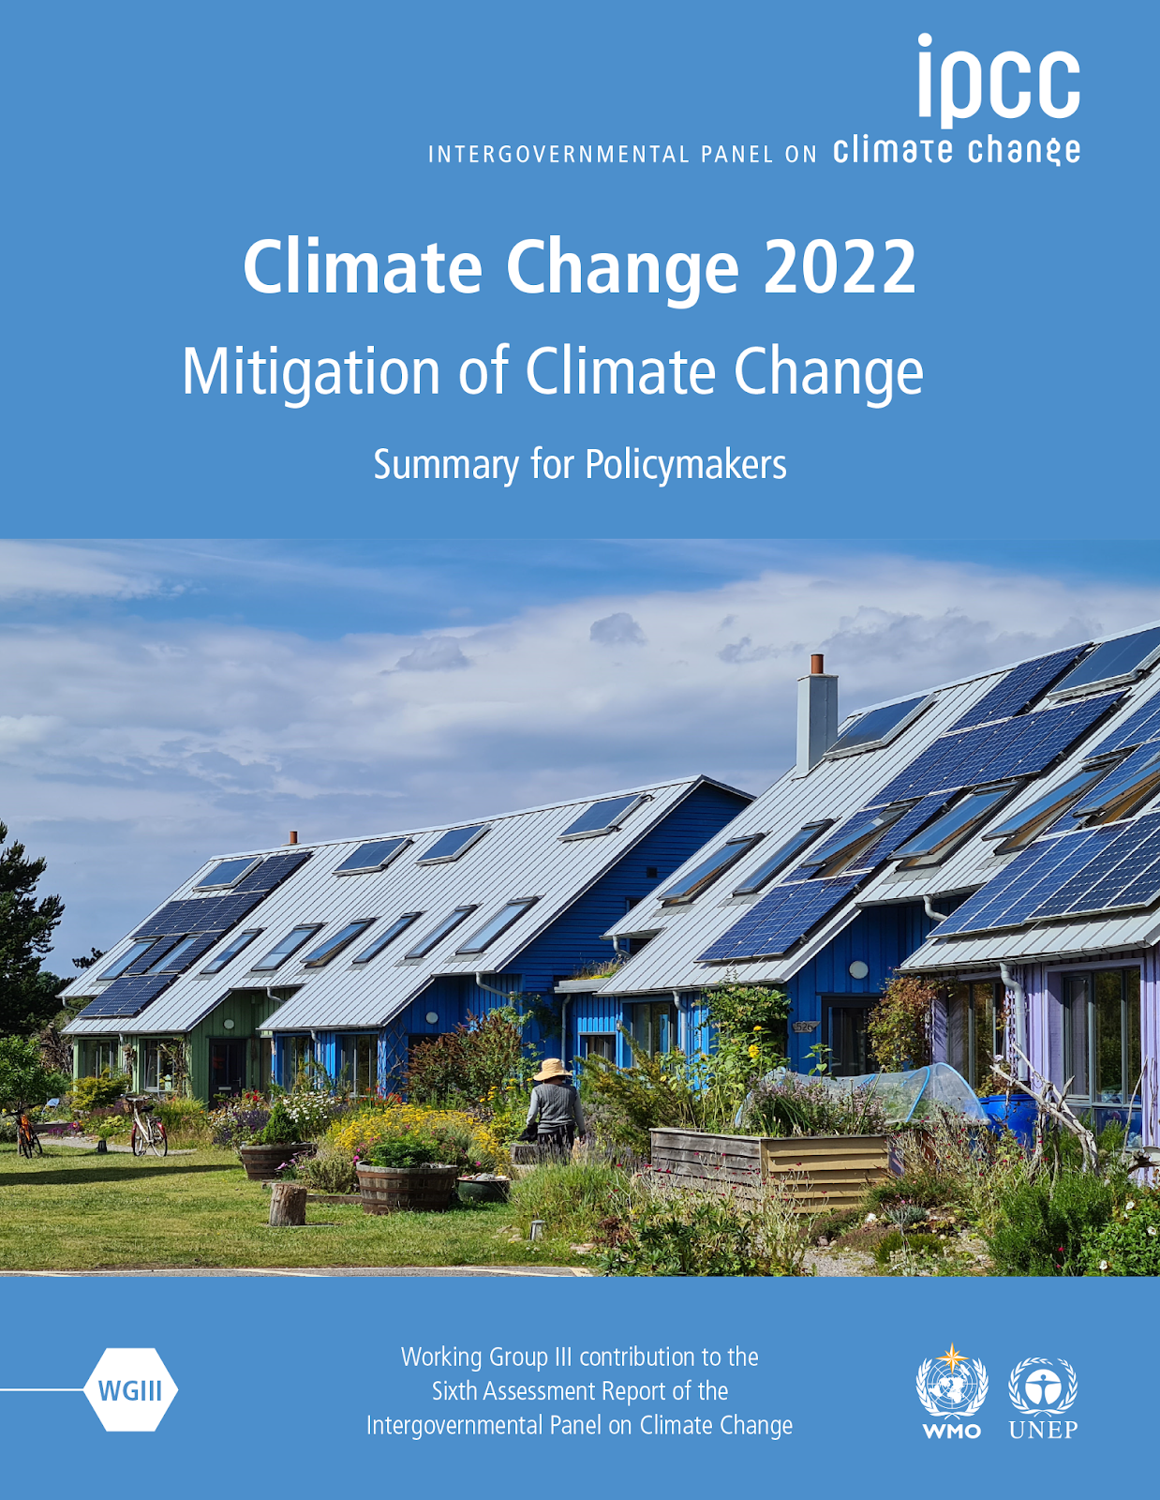
The impact: driving global climate assessments
CMIP has played a critical role in supporting the IPCC Assessment Reports, with CMIP data & papers being extensively used within the reports.

Slide 5
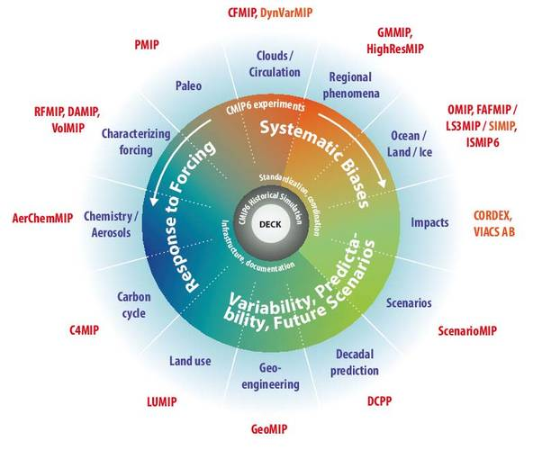
CMIP6: Bigger than ever
The 2018 WCRP review found, “A conservative estimate of the national investments in CMIP6 places their value in excess of US$3 bn, based on scientists’ time to develop and run the models and to design the experiments, and the supercomputing costs to deliver the simulations”.

Slide 6
CMIP6: Bigger than ever
Petabytes (unique data)
Over 100 models from more than 40 modelling centres across 27 countries
More than 28 PB of recorded CMIP6 downloads

Slide 7
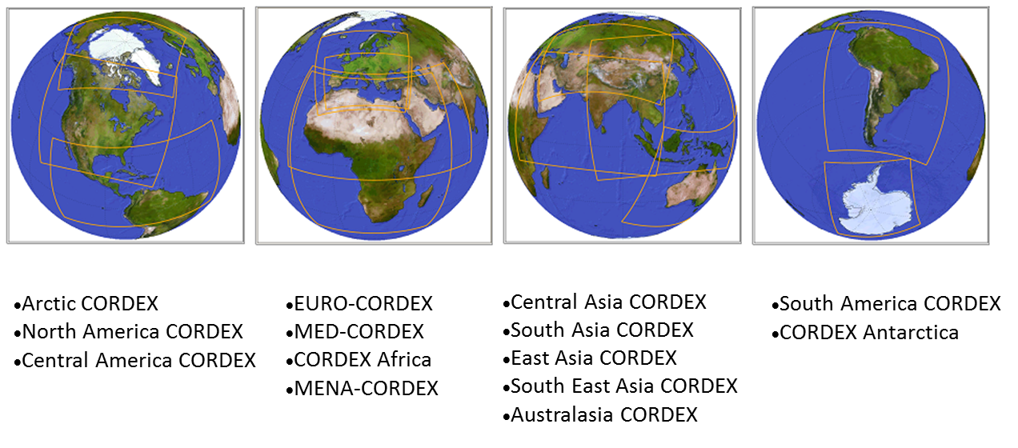
Coordinated Regional Downscaling Experiment (CORDEX)
www.cordex.org
14 domains covering all global land areas

Slide 8
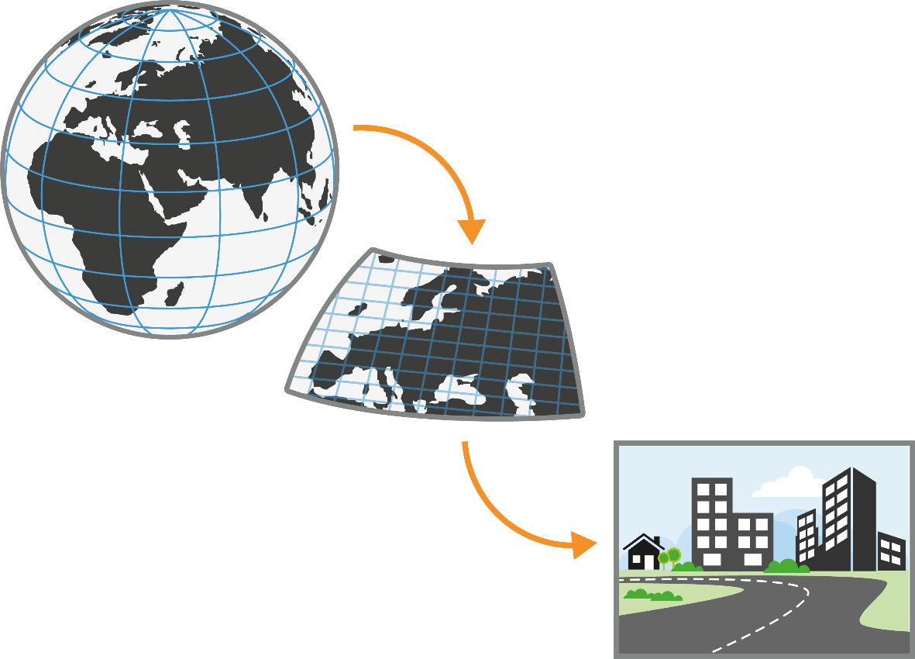
The chain from global to local - from data to knowledge to societal benefit -
Knowledge transfer, facilitation and capacity building
Global climate or earth system model
Regional climate model (12-25km)
CORDEX standard
Regional Climate Downscaling, with either Regional Climate Models or Empirical Statistical Downscaling, has an important role to play by providing projections with much greater detail and more accurate representation of localised extreme events.
Very High Resolution
Convection Permitting Model
1-3 km
(Flagship Pilot Studies)

Slide 9
The observations-modelling interface
Observations, such as the LST_CCI have an important role to play in:
Model evaluation
Model validation
Model initialisation
Process understanding
Land use/cover change
With accessibility, coverage and consistency in uncertainty quantification being key to use in both global and regional modelling.

Slide 10
Challenges
Ensuring comparability and understanding of variables.
Increasing model resolution (space and time)
Gaps in in-situ observational network and data access.
A shared understanding of uncertainty between modelling and observational communities (ESMO objective).
Quantifying Quantification of observational needs for modelling derived in a consistent way across at a global level (ESMO objective).
Access to tools, such as subsetting and regridding, to support range of modelling communities.

Slide 11
obs4MIPs targets observed variables that can be compared to CMIP model variables.
Utilizes dataset formatting specifications and metadata requirements closely aligned with CMIP model output
Provides brief technical documentation for each dataset, designed for nonexperts and tailored towards relevance for model evaluation, including information on uncertainty, dataset merits, and limitations.
Disseminates the data through the Earth System Grid Federation (ESGF) platforms, making the observations searchable and accessible via the same portals as the model output.
ESMValTool is a community diagnostic and performance metrics tool for routine evaluation of Earth system models that allows for routine comparison of single or multiple models, either against predecessor versions or against observations.
13 CCI datasets implemented into the tool including LST.
Ultimately, we envisage running the ESMValTool alongside the Earth System Grid Federation (ESGF) as part of a more routine evaluation of CMIP model simulations while utilizing observations available in standard formats (obs4MIPs) or provided by the user.

Slide 12
Thank you.
Please contact cmip-ipo@esa.int for further information

